Slide 1
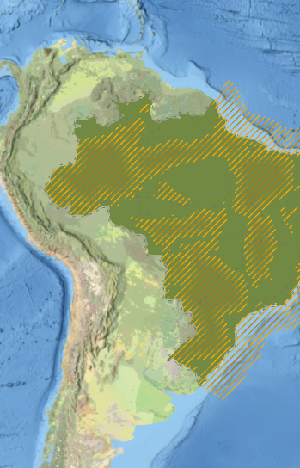
ZNMT 2023-2025
National Zoning of Oil and Gas Resources
Exploration and Production Team (E&P)
Superintendence of Oil and Natural Gas (SPG)

Slide 2
National Zoning of Oil and Gas Resources
2023–2025 Cycle
EPE 2025
Energy Research Office
Executive Summary
Technical Team
Technical Coordination
Energy Research Analysts
Technical Consultants
Executive Coordination
Camila da Mota Carvalho
Regina Freitas Fernandes
Director of Oil, Gas and Biofuels Studies
Denise dos Santos Silva Reinoldes
Roberta de Albuquerque Cardoso
Marcos Frederico Farias de Sousa
Katia Souza de Almeida
Heloisa Borges Bastos Esteves
Nathália Oliveira de Castro
Pamela Cardoso Vilela
Superintendent of Oil and Natural Gas
Péricles de Abreu Brumati
Marcos Frederico Farias de Sousa
Raul Fagundes Leggieri
Victor Hugo Trocate da Silva
Deputy Superintendent
Marcelo Ferreira Alfradique

Slide 3
Public Value
EPE conducts studies and research to support the formulation, implementation, and evaluation of Brazilian energy policy and planning.
Seeking to stimulate the market through analyses that may contribute to the adoption of appropriate strategies for the economically and environmentally sustainable development of hydrocarbon potential within the national territory, EPE publishes this study every two years.
By presenting expectations for hydrocarbon discoveries in each sedimentary basin and the relative importance of different areas of Brazil for the economic development of the oil and gas sector, the material made available supports the identification of medium- and long-term opportunities and provides guidance on how knowledge generated by this segment can contribute to pathways toward responsible, inclusive, and balanced development.

Slide 4
Disclaimer
The information provided in this publication reflects the views of the Energy Research Office (EPE). However, the content presented involves a range of known and unknown risks and uncertainties and, therefore, the data and analyses contained herein should be used for reference purposes only and do not constitute a guarantee of future outcomes or events.
This document is informational in nature and is intended to support the planning of the national energy sector. Therefore, any decisions (such as public policy formulation, definition of strategic guidelines, investment decisions, or business strategies) depend on other public and private institutions.
EPE disclaims any responsibility for actions or decisions that may be taken by economic agents or any individual based on the information contained in this document.

Slide 5
ZNMT 2023-2025
01
Study Context
02
Adopted Methodology
03
Geological Characterization
04
Economic Characterization
05
Focus on the Natural Gas Sector
06
Key Findings and Conclusions

Slide 6

STUDY CONTEXT

Slide 7
General Information
8th Edition
Published every two years, the study analyzes Brazilian sedimentary basins that present minimum conditions for the occurrence of oil and gas (O&G) accumulations and makes the generated data available to society in an organized georeferenced database.
The relative importance of different areas within the national territory for the economic development of the O&G sector is assessed in light of knowledge derived from multiple research initiatives, surveys, and data processing efforts in the fields of Geology, Geophysics, Geochemistry, and Engineering, many of which were conducted as inputs or as a legacy of the activities of the O&G sector in Brazil.
This edition is the eighth in a series of efforts initiated two decades ago by the EPE team, supported by the Ministry of Mines and Energy (MME), and structured to contribute to energy sector planning that is increasingly aligned with the national reality, including its strengths and challenges.

Slide 8












Guiding perspectives
ECONOMIC CHARACTERIZATION
Supply Infrastructure
Probability of Discovery
Fluid Type Expectation
Effective Basins
Volumetric Estimation
Prospectivity
Exploratory Plays
Exploration Activity
Hydrocarbon Evidence
Basin Selection
Exploitation Intensity
Need for Knowledge
GEOLOGICAL CHARACTERIZATION

Slide 9
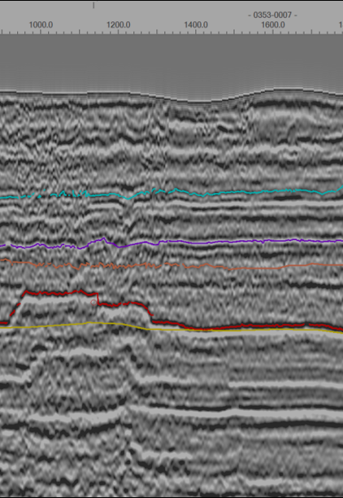
GEOLOGICAL CHARACTERIZATION

Slide 10
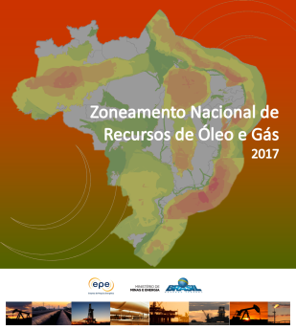
Geological Evaluation Effort Timeline
IHS Training
Seismic Interpretation Course
ROG Article (Seismic interpretation in Parecis Basin)
Seismic Room Inauguration
Interpretation Projects in Pará-Maranhão and Parnaíba basins
Seismic Interpretation Training
ANP Agreement
Kingdom Software Acquisition
Projects in Pelotas, Foz do Amazonas, Tucano Sul and Amazonas basins.
1st external Consultancy (analysis in Barreirinhas, Parnaíba and SEAL basins)
Structuring of primary datasets
Pelotas Basin seismic interpretation
2009
2016
2018
2020
2022
2024
2026
2011
2017
2019
2021
2023
2025
Free seismic interpretation software utilization
1st complete ZNMT publication
IHS Training
Seismic Interpretation x Opportunities Course
IHS Training
Interpretation Projects in Barreirinhas and Parnaíba basins
Parnaíba Basin Volumetric Assessment
External Consultancy (Analyses of Amazonas and Foz do Amazonas basins)
Projects in Pelotas, Tucano Sul, Foz do Amazonas and Parecis basins
Temis Flow geological modeling software acquisition

Slide 11
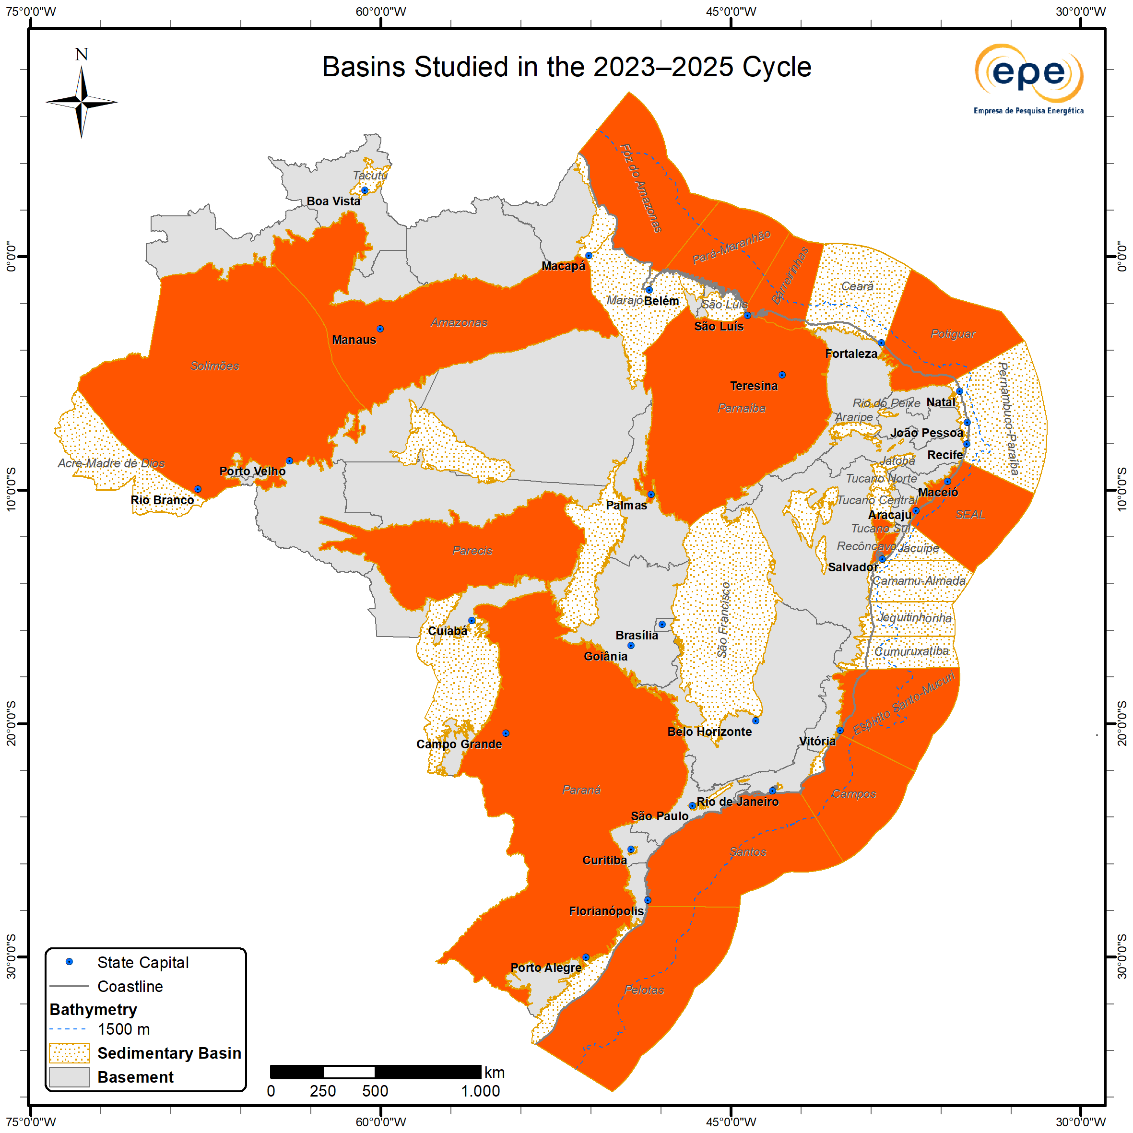
Studied Basin Portfolio
Starting from the 2019–2021 cycle, the basin portfolio for each cycle has been reassessed based on the availability of new data, aiming to improve the flow of the information presented and ensure alignment with the most recent expectations of the oil and gas sector.
In the 2023–2025 cycle, 19 sedimentary basins were selected to be revisited through the lens of exploration play analysis. These include:
- Southern East Margin – Pelotas, Santos, Campos, Espírito Santo-Mucuri;
- Northern East Margin – Sergipe-Alagoas (onshore and offshore);
- Equatorial Margin – Foz do Amazonas, Pará-Maranhão, Barreirinhas, Potiguar (onshore and offshore);
- Onshore Basins – Amazonas, Solimões, Parnaíba, Parecis, Paraná, Recôncavo, and Tucano Sul
The Pelotas Basin, motivated by recent oil and gas discoveries in the prolific Orange Basin in Namibia, and the Foz do Amazonas Basin, driven by recent large-scale discoveries in the Stabroek block (Guyana-Suriname Basin), received greater focus during this cycle. This included the incorporation of analyses derived from the interpretation of primary seismic and well data - an effort that EPE has been intensifying since 2021 to deepen basin evaluations.
The results of the analysis of the plays identified in the basins studied during this cycle are presented below in the Probabilistic Effective Basin Map, together with the results for the remaining basins analyzed in the previous cycle.
For further detail, both regarding basins not covered in the 2023–2025 cycle and methodological aspects, the following reports are recommended:
ZNMT Report Cycle 2017–2019 (MME/EPE, 2019) - methodological deepening
ZNMT Report Cycle 2019–2021 (MME/EPE, 2021)
ZNMT Report Cycle 2021–2023 (MME/EPE, 2021)
ZNMT 2023-2025

Slide 12
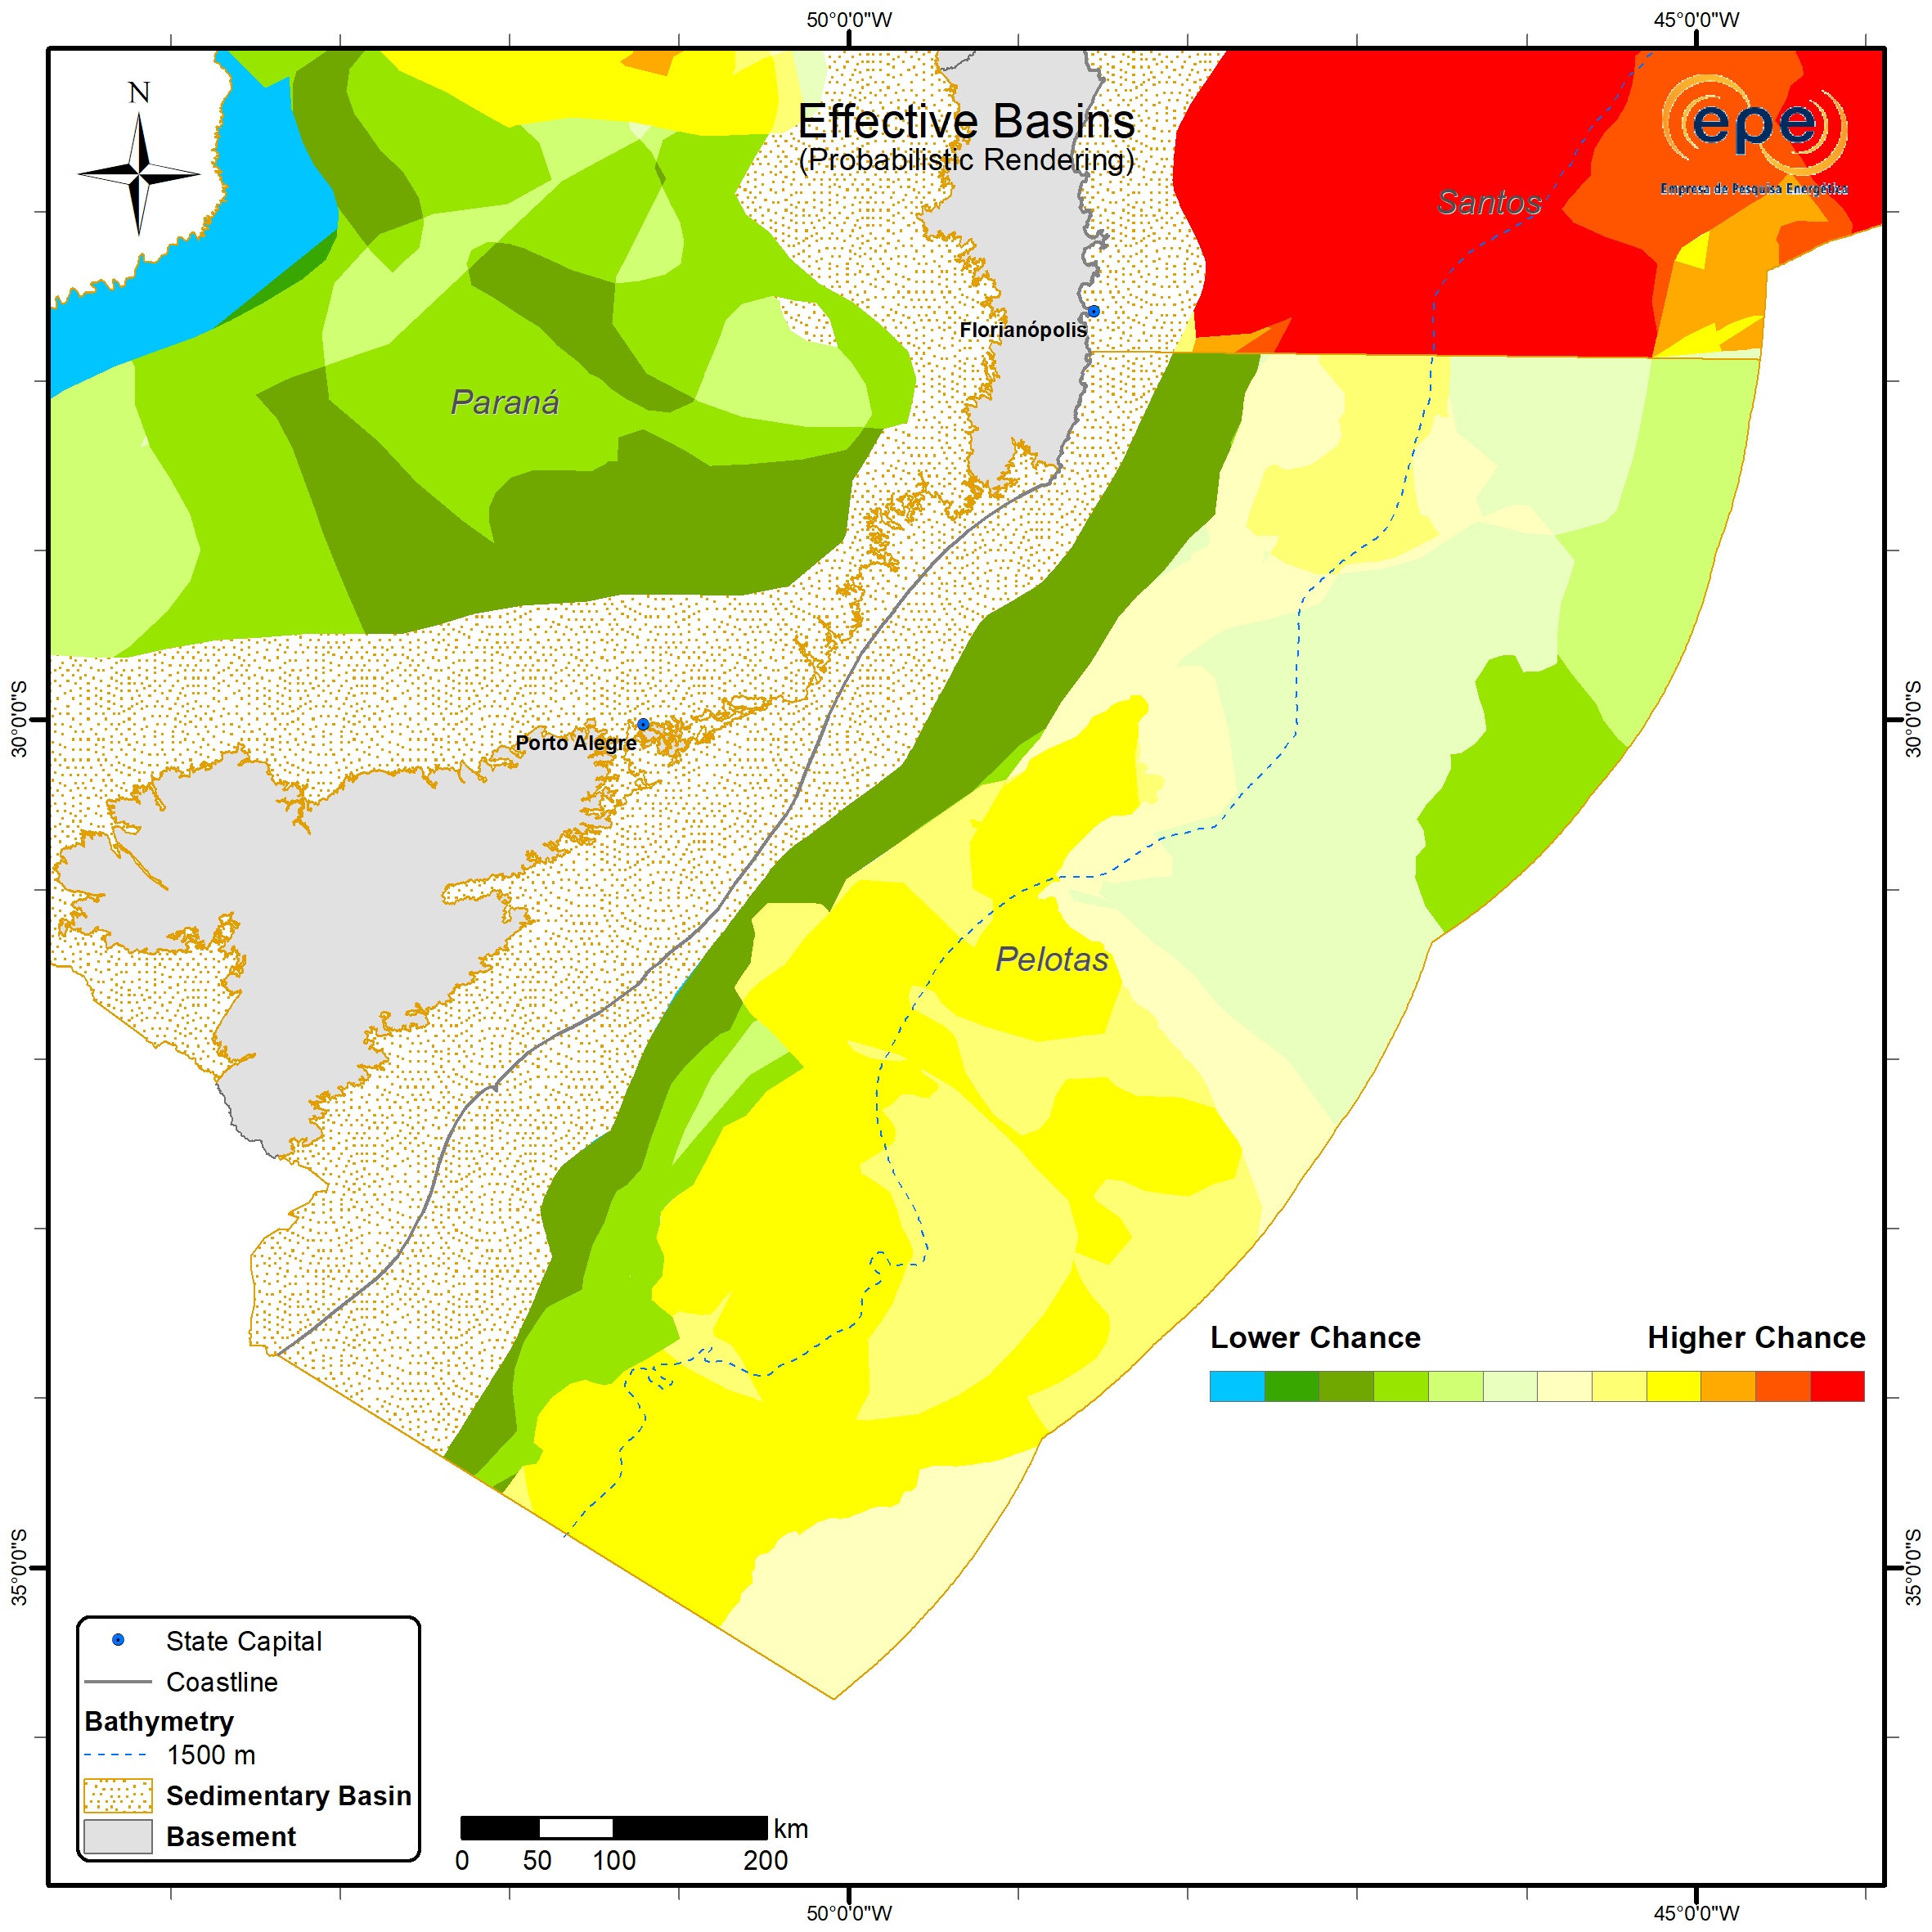
Advances in the Pelotas Basin
In the 2023–2025 cycle, EPE focused its efforts on the Pelotas Basin, motivated by recent oil and gas discoveries in the prolific Orange Basin, in Namibia. More than 450 2D seismic lines were used, covering nearly the entire extent of the basin within Brazilian territory, approximately 346,873 km², up to the 200-nautical-mile territorial limit. To identify the stratigraphic intervals bounding the occurrence of exploration plays, all eight wells drilled in the offshore portion of the Pelotas Basin were tied.
Although the presence of mature source rock has not yet been successfully proven in the Pelotas Basin, the oil and gas discoveries in the prolific Orange Basin demonstrate the existence of a world-class Aptian source rock in the conjugate margin¹.
Furthermore, there is a possibility that Lower Cretaceous and Cenomanian-Turonian source rocks may be within the hydrocarbon generation window in the Pelotas Basin². Accordingly, in the 2023–2025 cycle, the charge element of the petroleum system was evaluated based on the presence and thickness of the stratigraphic interval between the top of the rift and the top of the Turonian. This assessment enabled a better definition of potential source kitchens in the northern and southern Pelotas sub-basins.
Similarly, the reservoir element was assessed based on the presence and thickness of stratigraphic intervals capable of hosting reservoir rocks for each of the basin’s plays. The resulting maps highlight a greater sediment supply in the southern Pelotas sub-basin, where most of the identified exploration opportunities are concentrated. The analysis also allowed the redefinition of chance factors in the more offshore portions of the basin, increasing confidence in the evaluations conducted.
Another important risk factor for hydrocarbon accumulations in the Pelotas Basin is the existence of migration pathways connecting potential source rocks to reservoirs. To better address this risk, the Imbé Turbidite play was subdivided into the Imbé Upper Cretaceous and Imbé Paleogene–Neogene plays.
Seismic interpretation also made it possible to distinguish between portions of the rift interval dominated by grabens filled with alluvial and conglomeratic deposits and those dominated by volcanic rocks (seaward dipping reflectors – SDRs). This led to the identification of a new play in the basin, the Imbituba play, which still requires further investigation, similar to what was discussed by Conti et al. (2017) for the Uruguayan sector of the Pelotas Basin.
For the next study cycle, the objectives include the characterization and volumetric assessment of exploration opportunities identified in the Porto Belo, Atlântida, and Imbé Upper Cretaceous plays, which are currently of greatest interest to the oil and gas industry in the Pelotas Basin³.
ZNMT 2023-2025
¹ (RODRIGUEZ; HODGSON, 2024).
² (ANP, 2022; CONTI et al., 2017)
³ (ZALÁN, 2017)

Slide 13
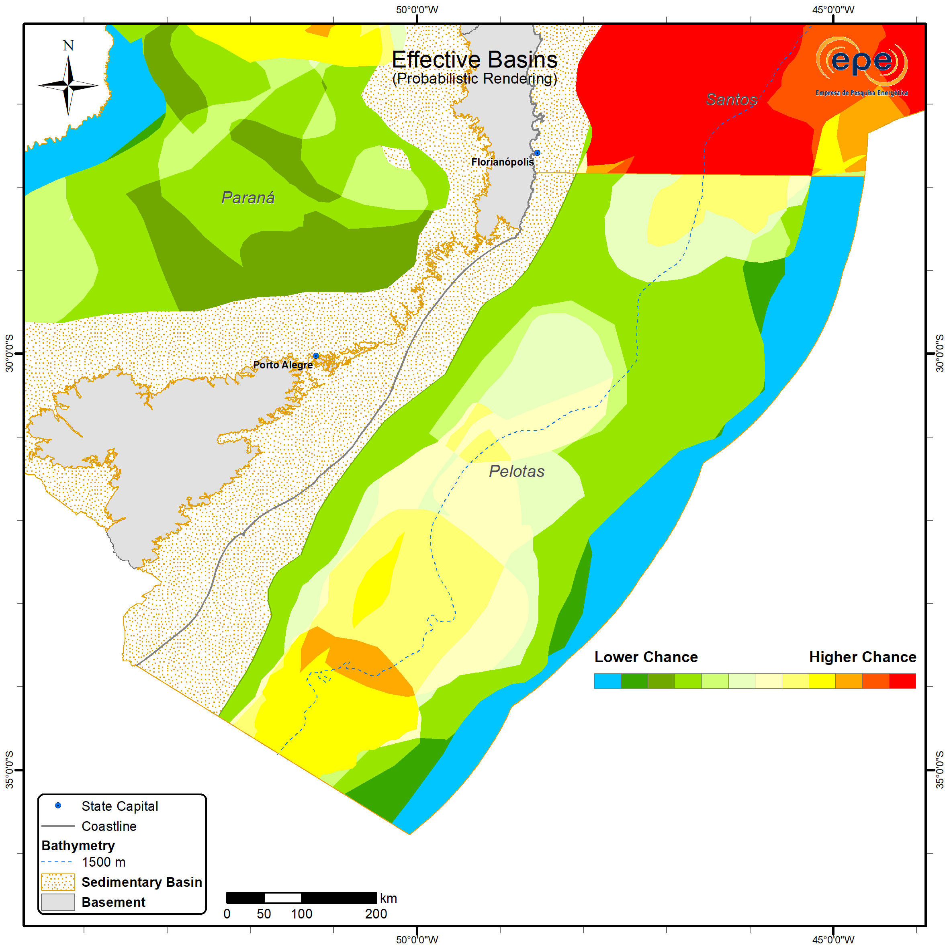
Advances in the Pelotas Basin
The probabilistic Pelotas Basin in the current cycle maintains a configuration similar to the previous publication, with areas of higher chance associated with potential hydrocarbon-generating kitchens to the north, at the boundary with the Santos Basin, and to the south, over the Rio Grande Cone.
The variation observed in the design of the segments is the result of a more detailed interpretation of the limits of these kitchens, which became possible through the interpretation of primary seismic and well data, initiated by EPE in 2020, and which for the first time feeds the ZNMT for the Pelotas Basin.
ZNMT 2021-2023
ZNMT 2023-2025
Likewise, the interpretation of reservoir and trap elements in 2D seismic lines was responsible for increasing the chance of the more distal segments of the basin, within the domain of oceanic crust. In previous versions of the ZNMT, the near absence of data on these segments resulted in minimum probability values due to uncertainty in the interpretation of the chances of occurrence of the petroleum system elements required for a hydrocarbon accumulation.

Slide 14
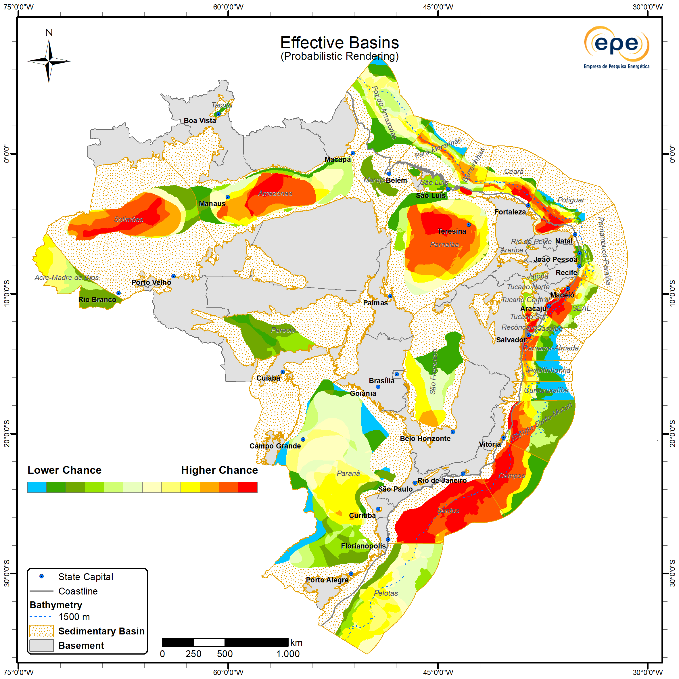
Probabilistic Effective Basin
The current cycle includes the representation of the probability of hydrocarbon accumulations associated with 167 exploratory plays, distributed across 34 sedimentary basins¹. Overall, few changes were observed in the final expectations for each basin compared to the previous cycle (2021–2023).
In the onshore basins, the main changes relate to the revision of the exploration status of the Nova Olinda play (Pennsylvanian fluvio-deltaic–estuarine sandstones) in the Amazonas Basin, which led to an increase in probability in the central-western portion of the basin, as well as adjustments to the only play in the Parecis Basin (Neoproterozoic shallow-marine sandstones and carbonates), resulting in reduced expectations in the western portion. In the Parnaíba Basin, internal advancements in primary data analysis supported increased expectations in the central portion of the basin.
In the Northern East Margin, the most noticeable change is related to the adjustment of continuity between exploratory plays in the Jequitinhonha and Camamu-Almada basins.
In the Equatorial Margin, the Foz do Amazonas Basin concentrated a significant portion of the efforts undertaken in this cycle, with several improvements implemented in the Albian–Maastrichtian turbidite sandstone play (Limoeiro play), based on the experience gained from the specialized consultancy, as detailed in the following pages.
In the Southern East Margin, the interpretation of seismic survey data in the Santos Basin enabled a revision of the continental–oceanic crust boundary, leading to updates in the external limits of the plays in this basin. In the Pelotas Basin, the effort dedicated to interpreting primary data, described in the following section, resulted in an extensive revision of pre-existing plays. This led to improved segmentation between Paleogene–Neogene marine turbidite sandstone reservoirs (Imbé Paleogene–Neogene play) and Upper Cretaceous reservoirs (Imbé Cretaceous play), as well as the identification of a distinct play representing basalts, shales, and sandstones from the Neo-Jurassic to Early Cretaceous (Imbituba play).
ZNMT 2023-2025
¹ Includes the 19 basins analyzed in the current cycle under the play-based analysis approach, as well as the remaining basins analyzed in previous cycles.

Slide 15
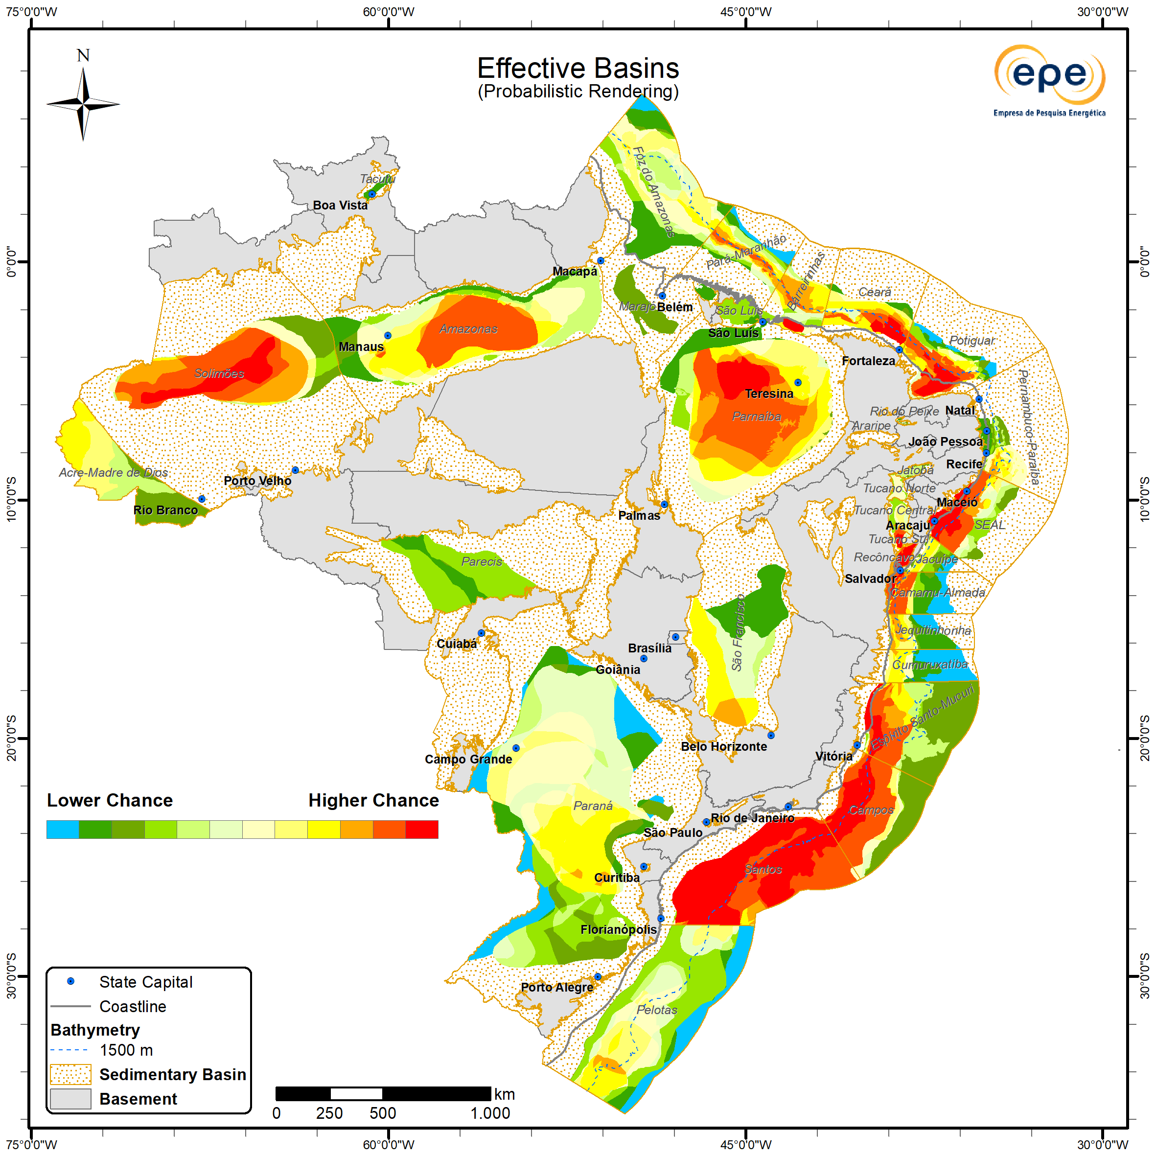
Probabilistic Effective Basin

Slide 16
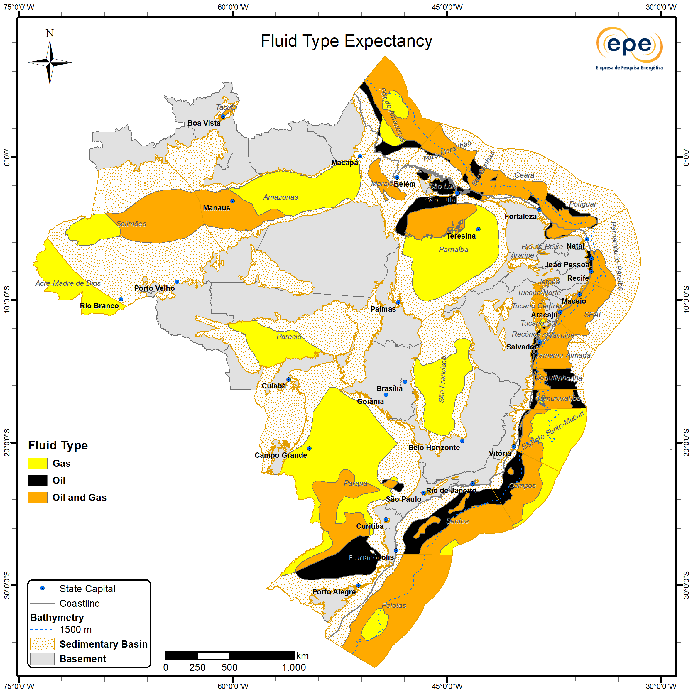
Fluid Expectation
Within the georeferenced database, information is provided on fluid expectations at the play level and on the predominant fluid by basin, the latter derived from the combination of the former.
In the 2023–2025 cycle, a greater propensity for non-associated gas accumulations was observed in the onshore basins (Acre-Madre de Dios, Solimões, Amazonas, Parecis, Parnaíba, São Francisco, and Paraná). In the Southern East Margin, expectations for gas occur offshore in the Espírito Santo-Mucuri and Campos basins; in the Santos Basin, outside the extent of the salt wall; and in the Pelotas Basin, particularly in the Rio Grande Cone region. In the Foz do Amazonas Basin, gas expectations are higher in its central portion.
Predominantly oil-prone expectations were observed in proximal areas between the Santos and Camamu-Almada basins, between the Potiguar and Foz do Amazonas basins, as well as in the onshore Paraná and Parnaíba basins.
Oil and gas are expected in the regions of the Jacuípe, SEAL, and Pernambuco-Paraíba basins. Mixed expectations are also observed across most of the Pelotas Basin - except in the Rio Grande Cone region, which represents the main change compared to the previous cycle, where gas is now the dominant expectation - and across much of the pre-salt polygon, as well as in a large portion of the equatorial margin basins.
ZNMT 2023-2025

Slide 17
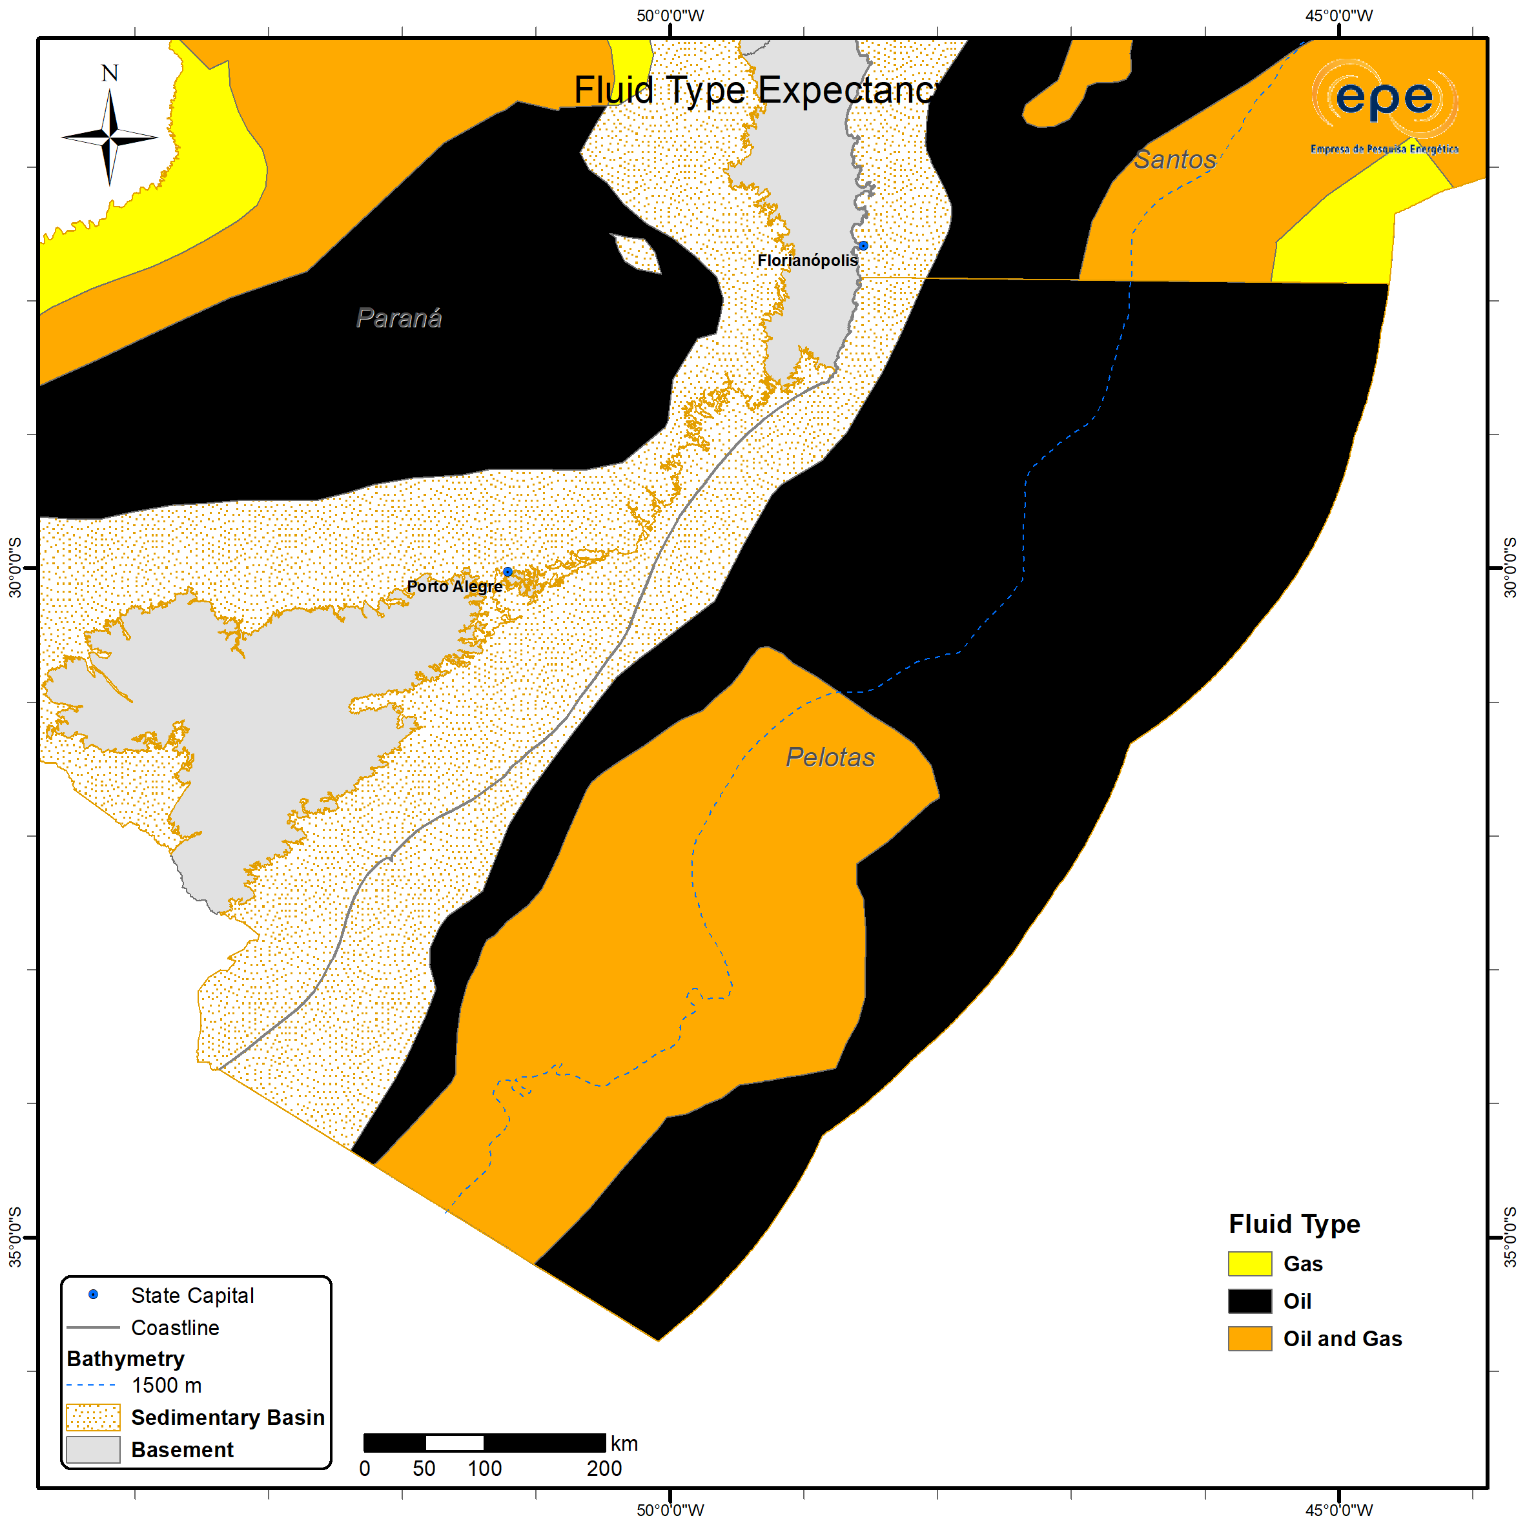
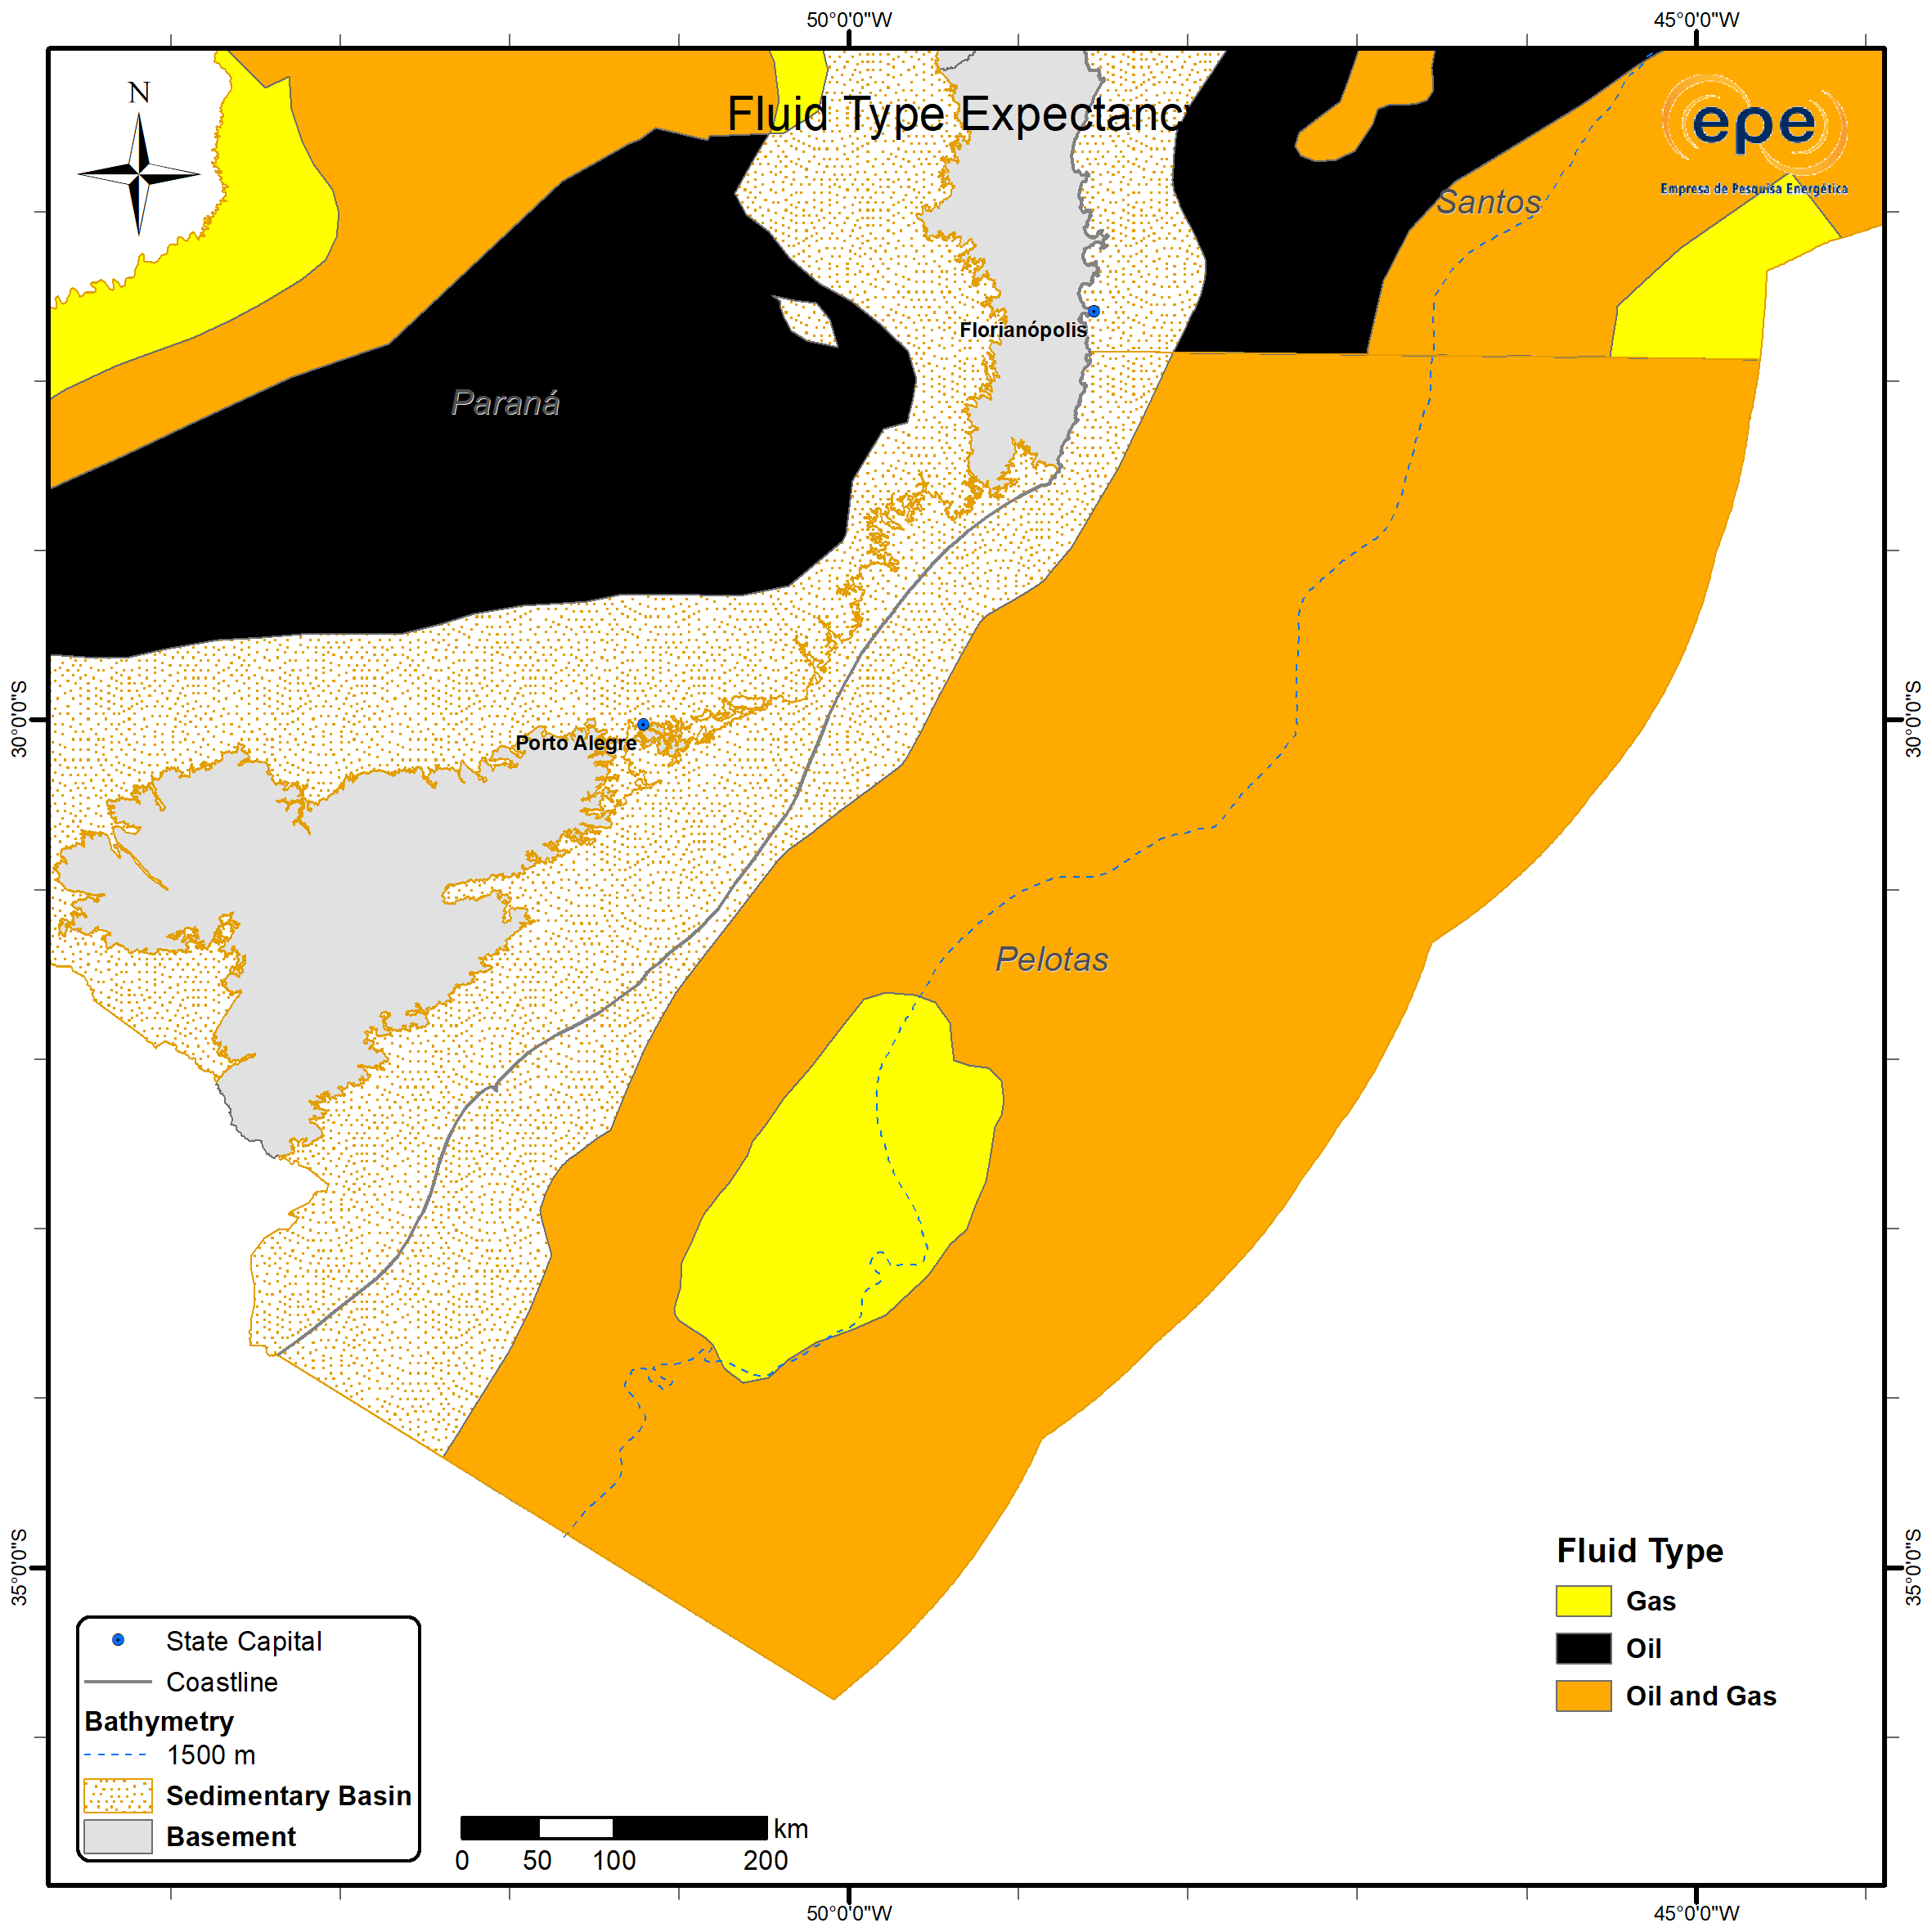
Fluid Expectation in Pelotas Basin
Once well and core data were incorporated, together with the execution of geochemical analyses for the evaluation of the Pelotas Basin, there was a change in the expectations regarding the predominant fluid types in this basin.
A greater propensity for the occurrence of gas is now estimated for the Rio Grande Cone region, while for the other areas, a propensity for gas and light oil is projected, similar to what has been observed in recent discoveries in the Orange Basin, on the conjugate African margin.
For the other basins, there were no changes.
ZNMT 2021-2023
ZNMT 2023-2025

Slide 18
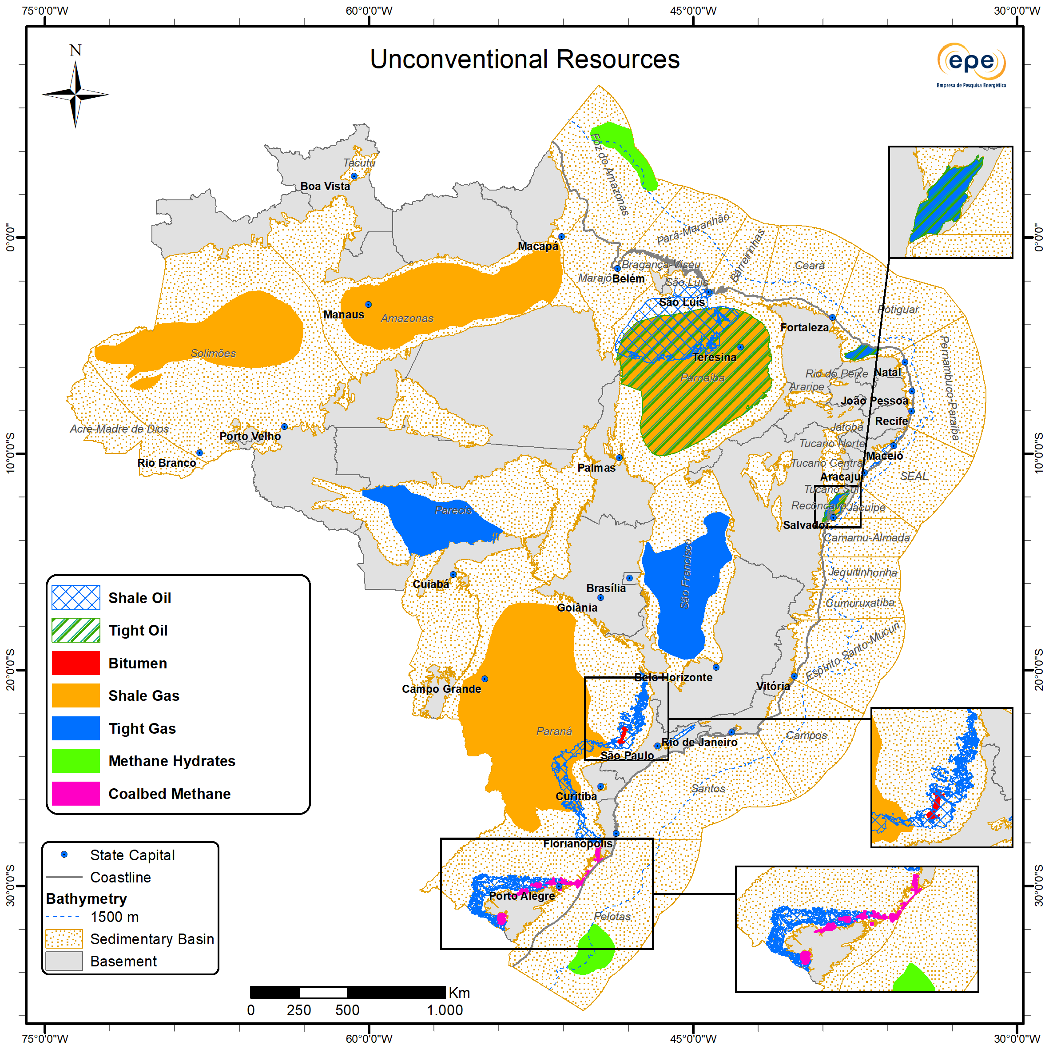
Unconventional Resources
As in previous cycles, the indication of the potential occurrence of seven types of unconventional resources distributed across 14 Brazilian basins has been maintained:
  Bitumen or Oil Sands (Betuminous Sands / Oil Sands / Tar Sands)
  Shale Oil
  Tight Oil Formations
  Shale Gas
  Tight Gas Formations
  Gas Hydrates
  Coalbed Methane
Although a concentration of potential occurrences is expected in onshore environments, no exploratory risk analysis was conducted for this group. Therefore, it is not possible to draw conclusions regarding the probability of discovery of accumulations in each case.
ZNMT 2023-2025

Slide 19

ECONOMIC CHARACTERIZATION

Slide 20
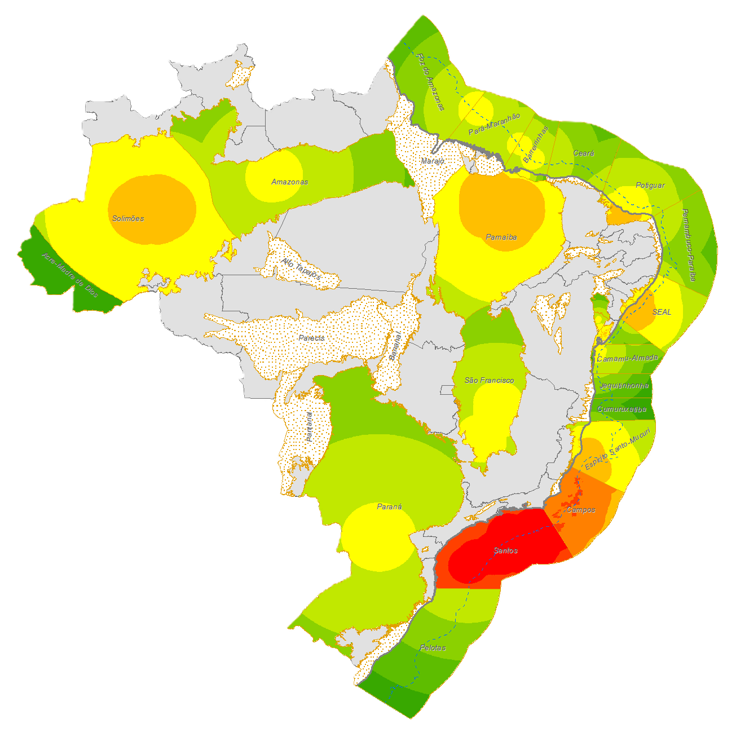
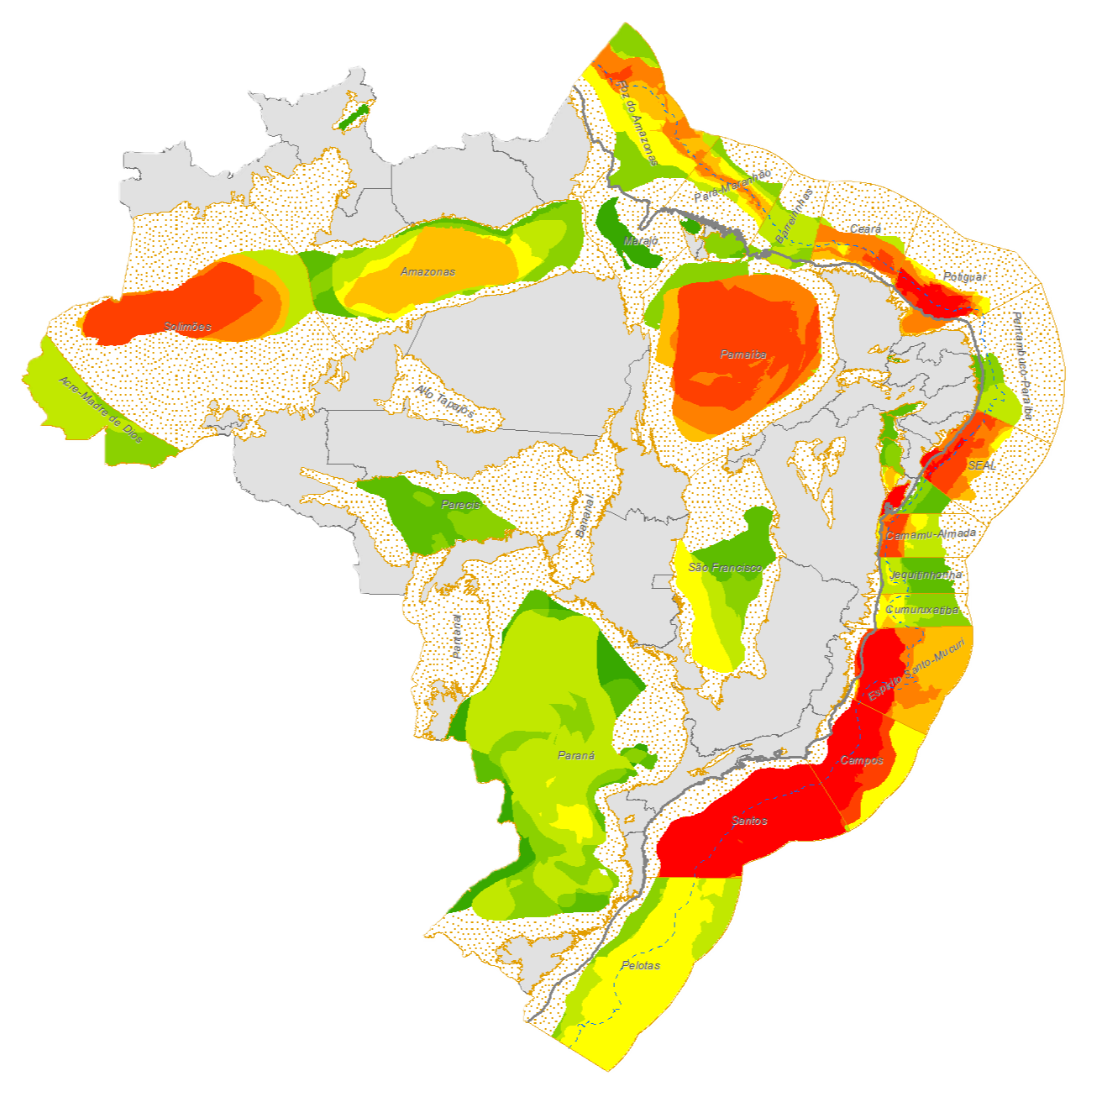
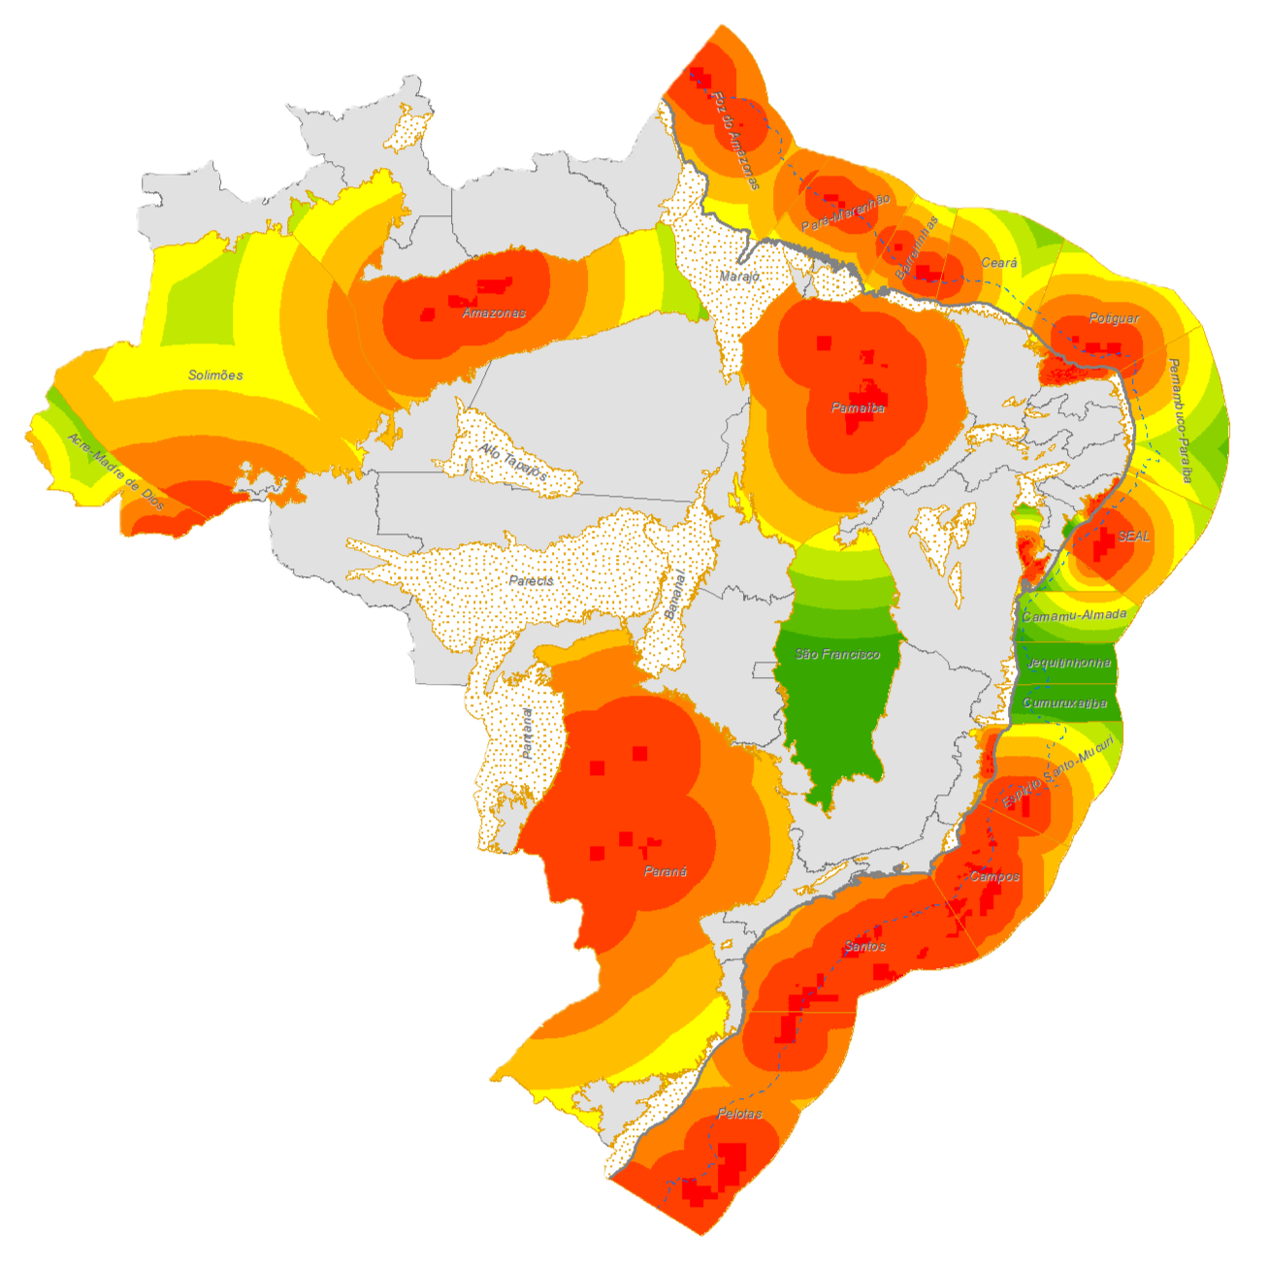
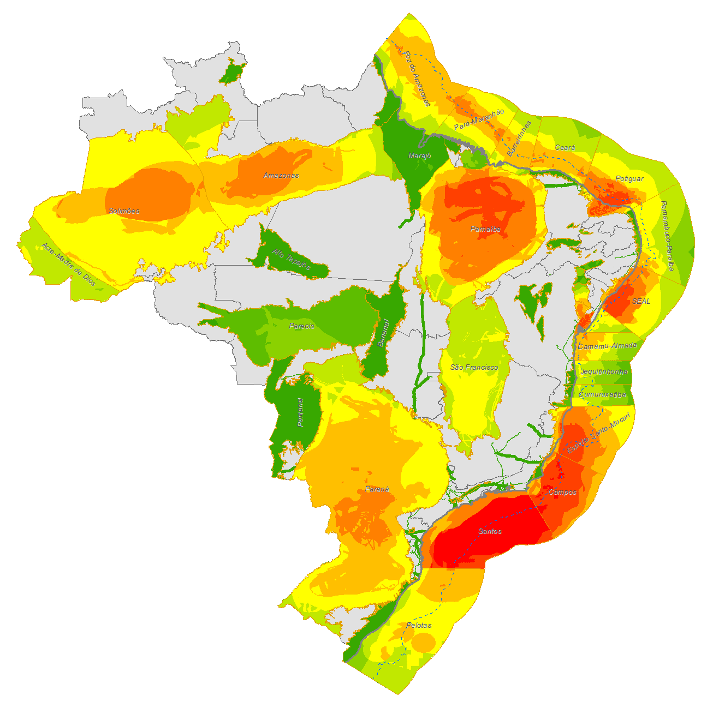
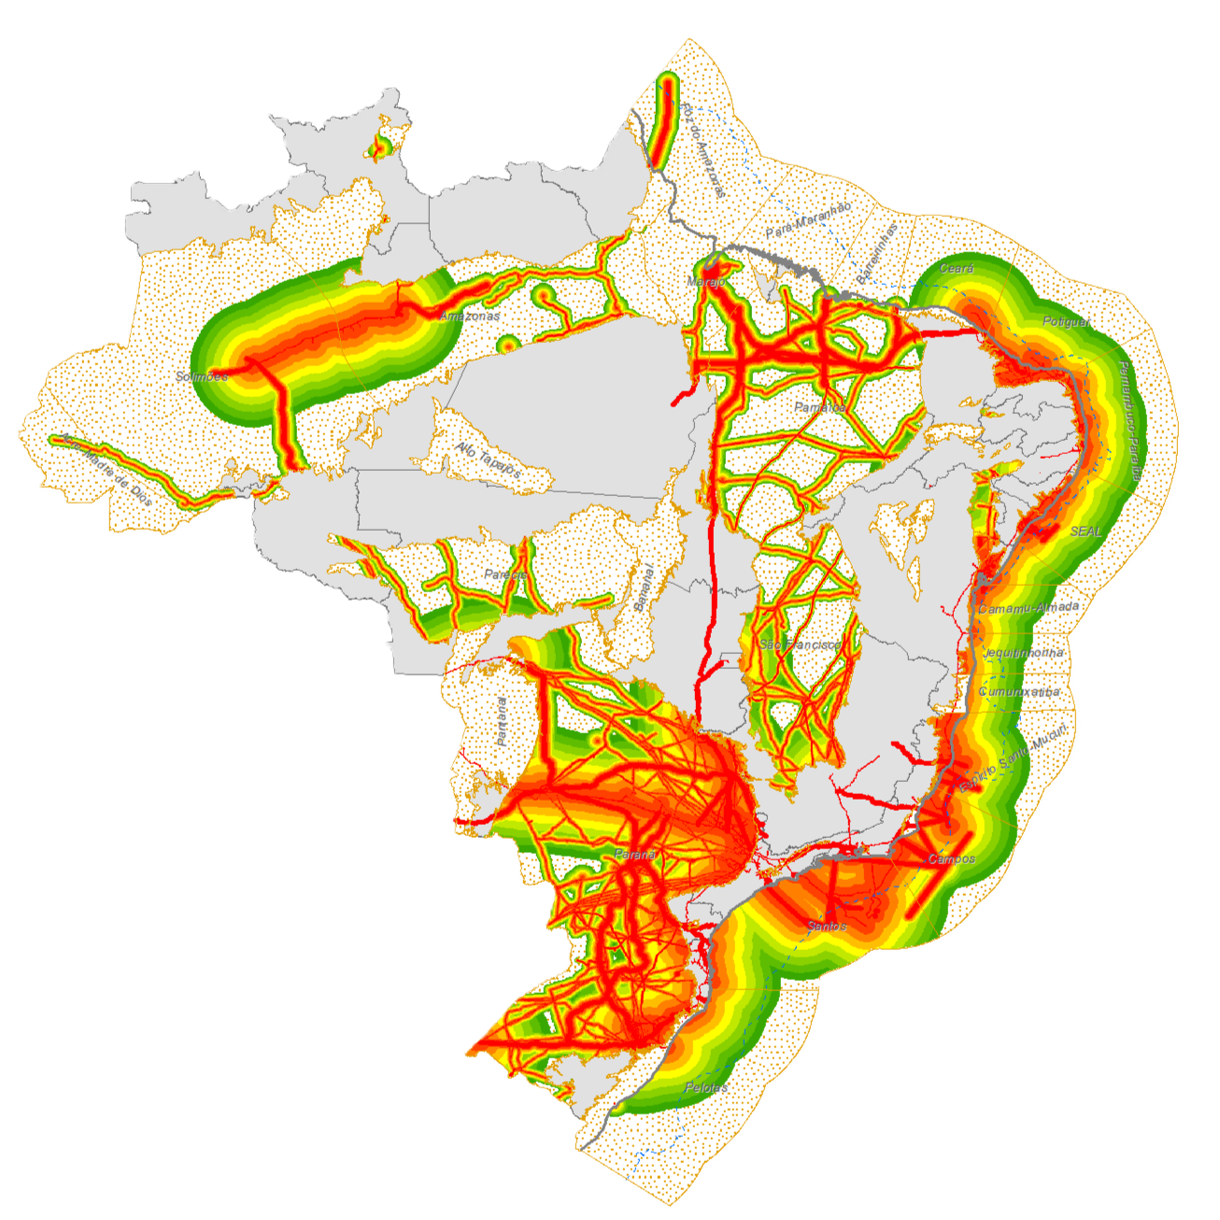
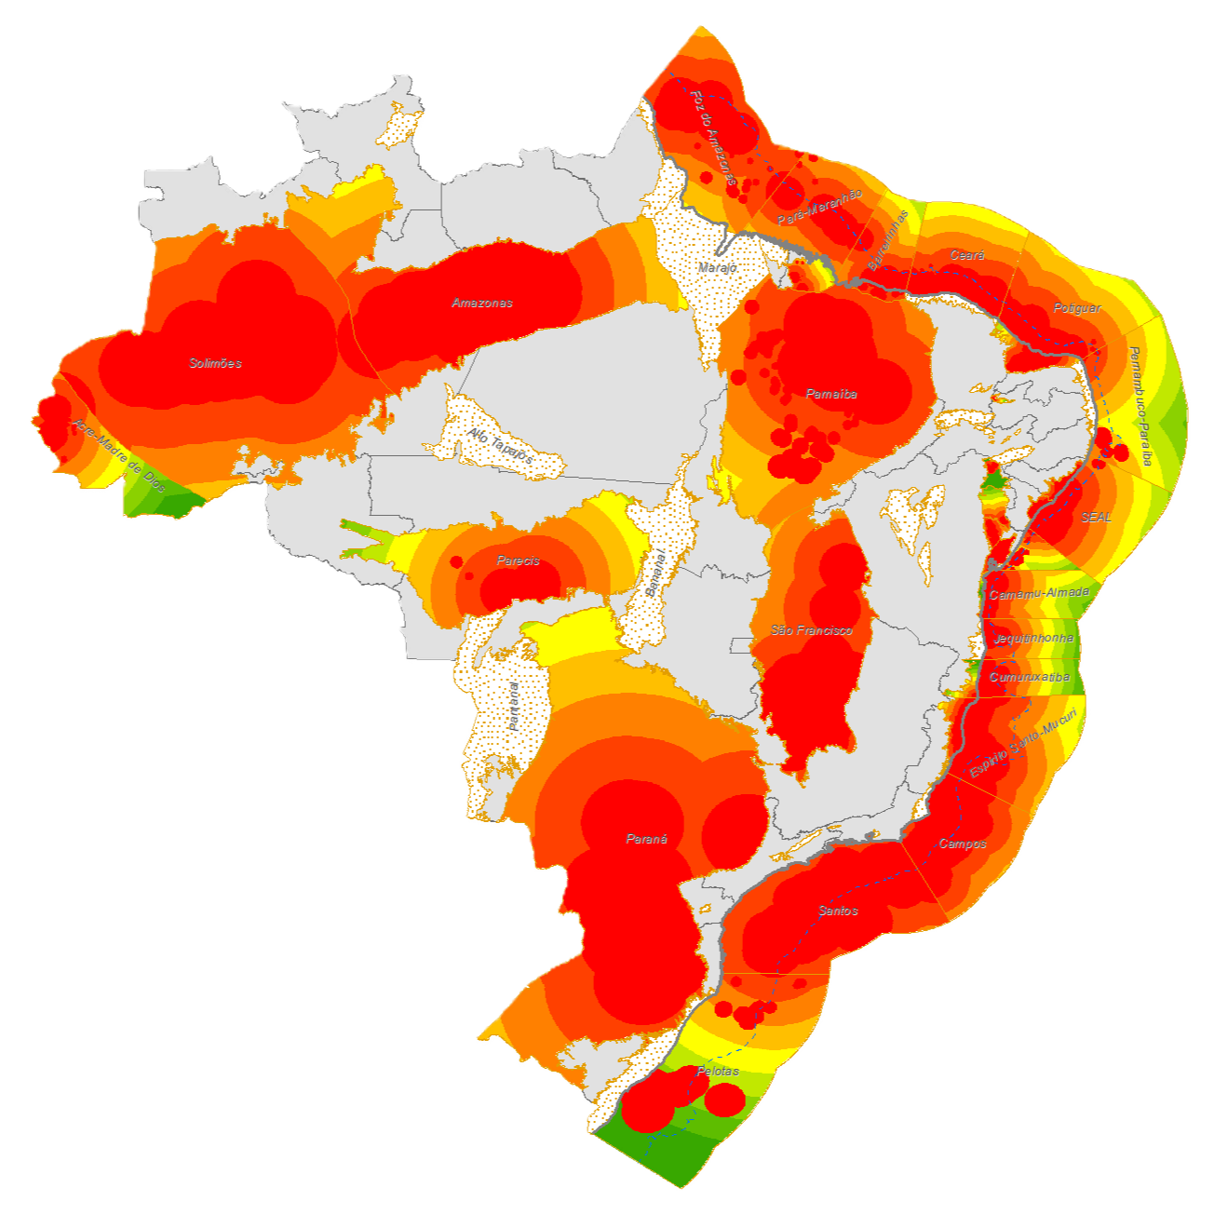
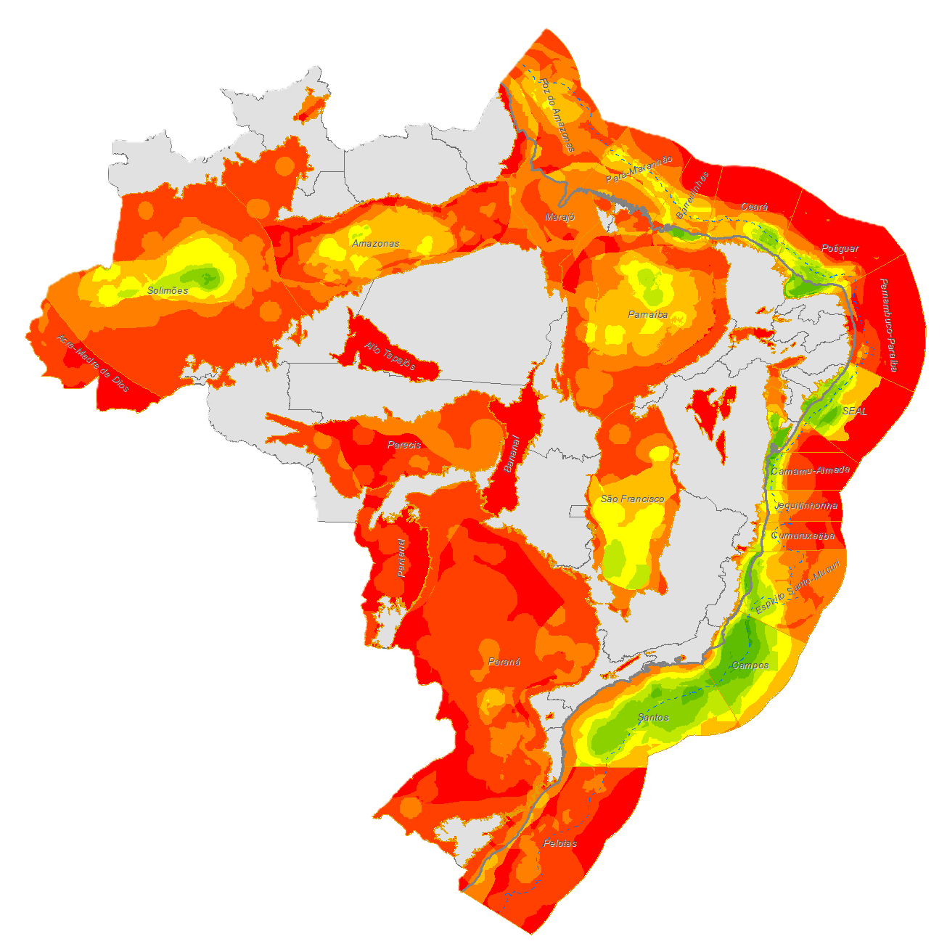

Areal Petroleum Importance
IPA Total
Exploitation Intensity
Prospectivity
Exploratory Activity
Multi-Criteria Area Importance Function
Supply Infrastructure
Hydrocarbon Evidence
Knowledge Requirement

Slide 21
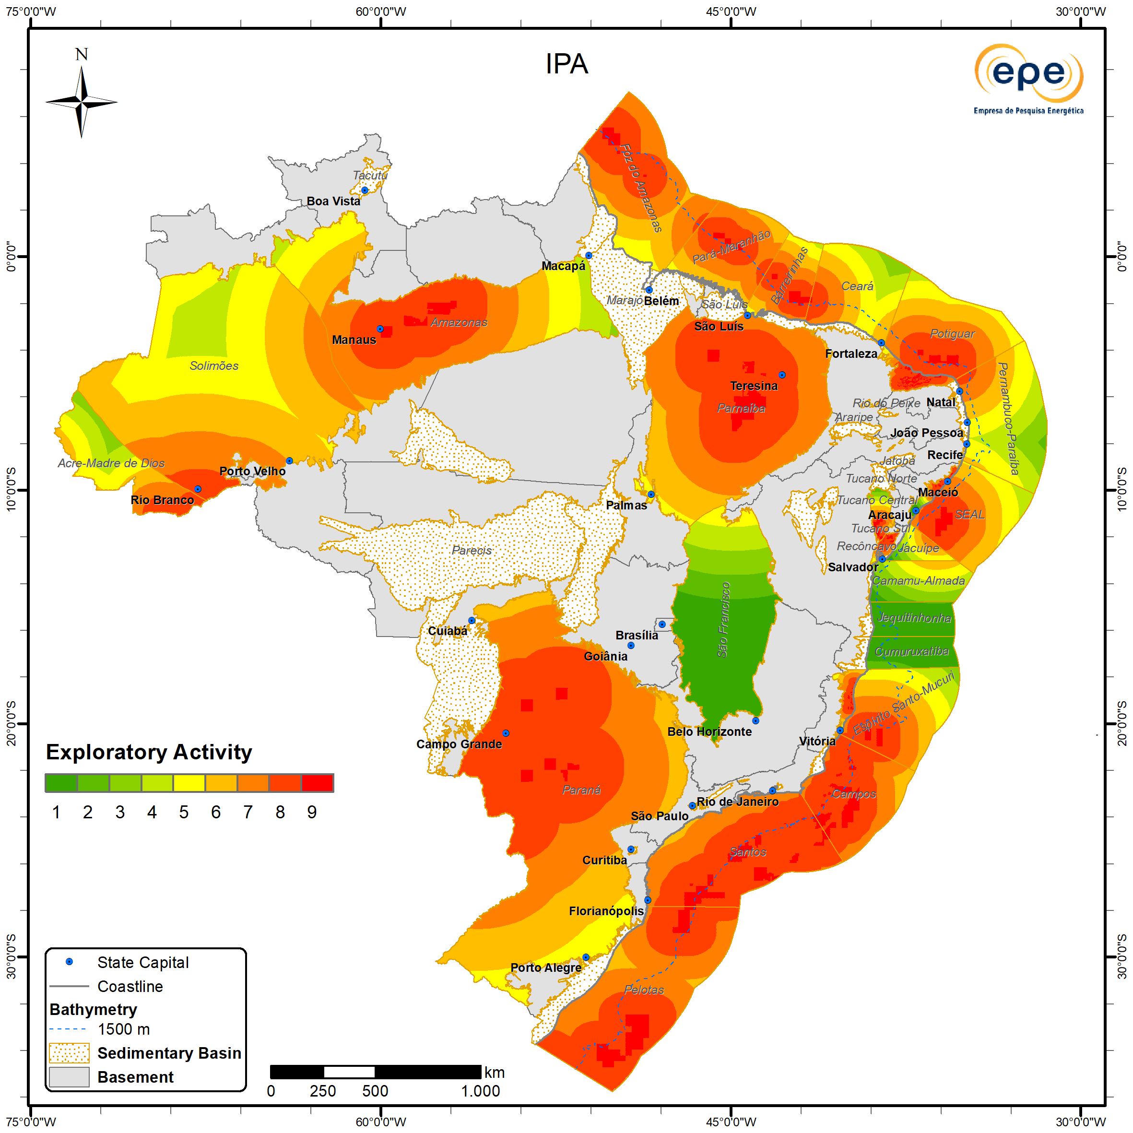
1. Exploration Activity
Description
Represents the importance of areas under contract for E&P activities that are still in the exploration phase.
Importance is inversely proportional to the distance between exploration blocks and any given point within a basin.
It also considers information from neighboring basins in Latin America.
The reference date used is February 28, 2025.
ZNMT 2023-2025

Slide 22
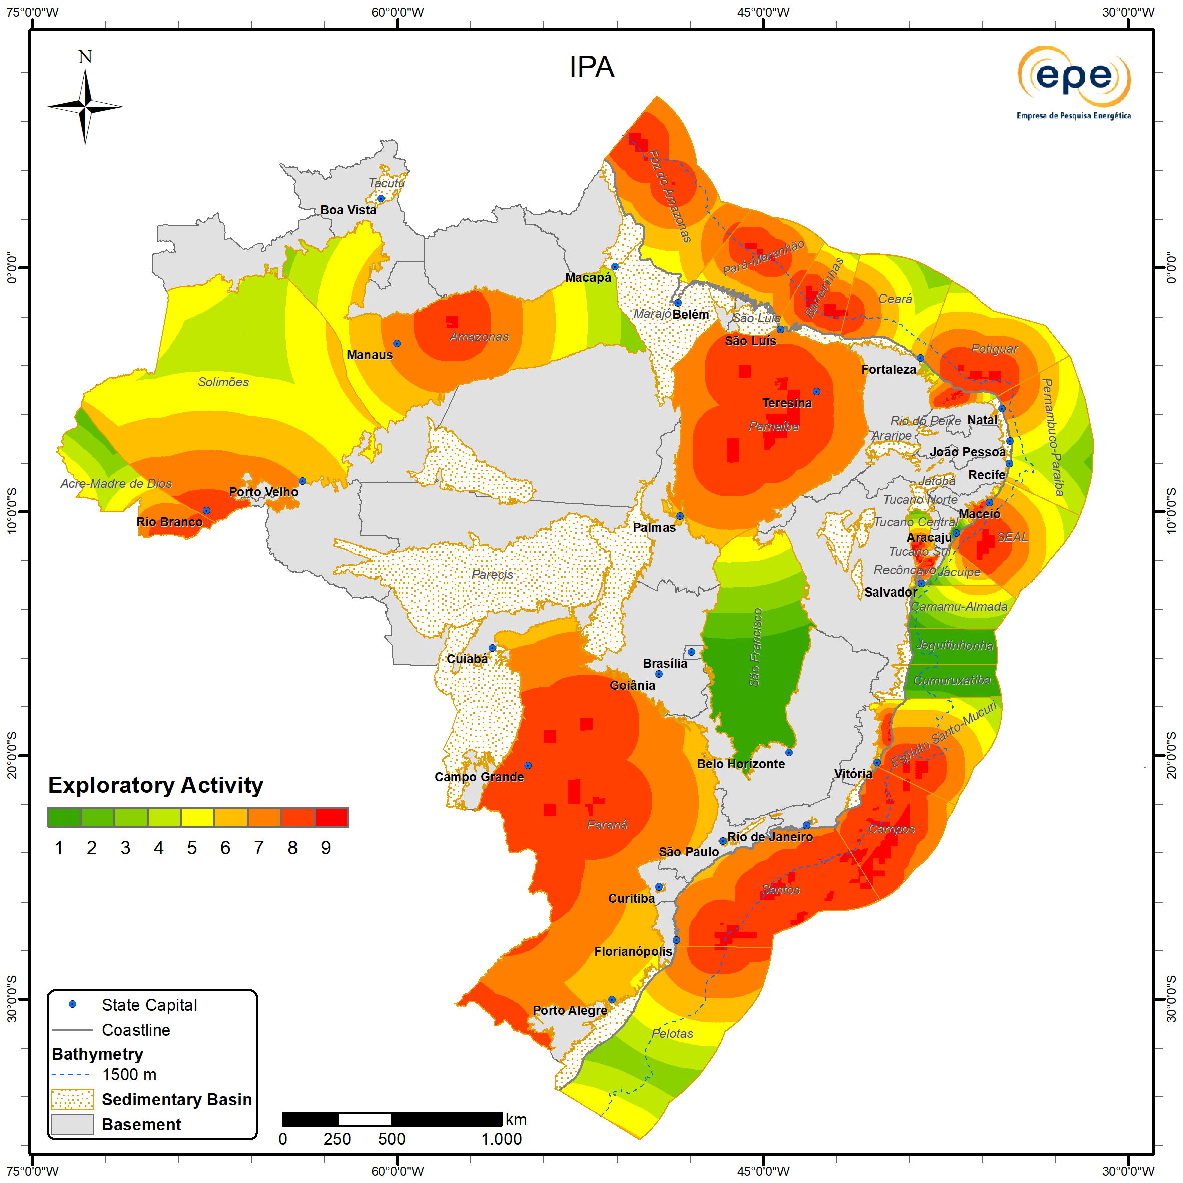
Exploration Activity
Updates
Among the main changes compared to the 2021–2023 cycle is the increase in importance in the Amazonas and Pelotas basins, associated with the awarding of blocks in the 4th Permanent Offer Cycle.
On the other hand, a slight decrease in importance is observed in the southern portion of the Paraná Basin, related to changes in the portfolio of contracted blocks located in the onshore portion of Uruguay, which, according to the Administración Nacional de Combustibles, Alcoholes y Portland (ANCAP), are no longer under contract.
ZNMT 2021-2023
ZNMT 2023-2025

Slide 23
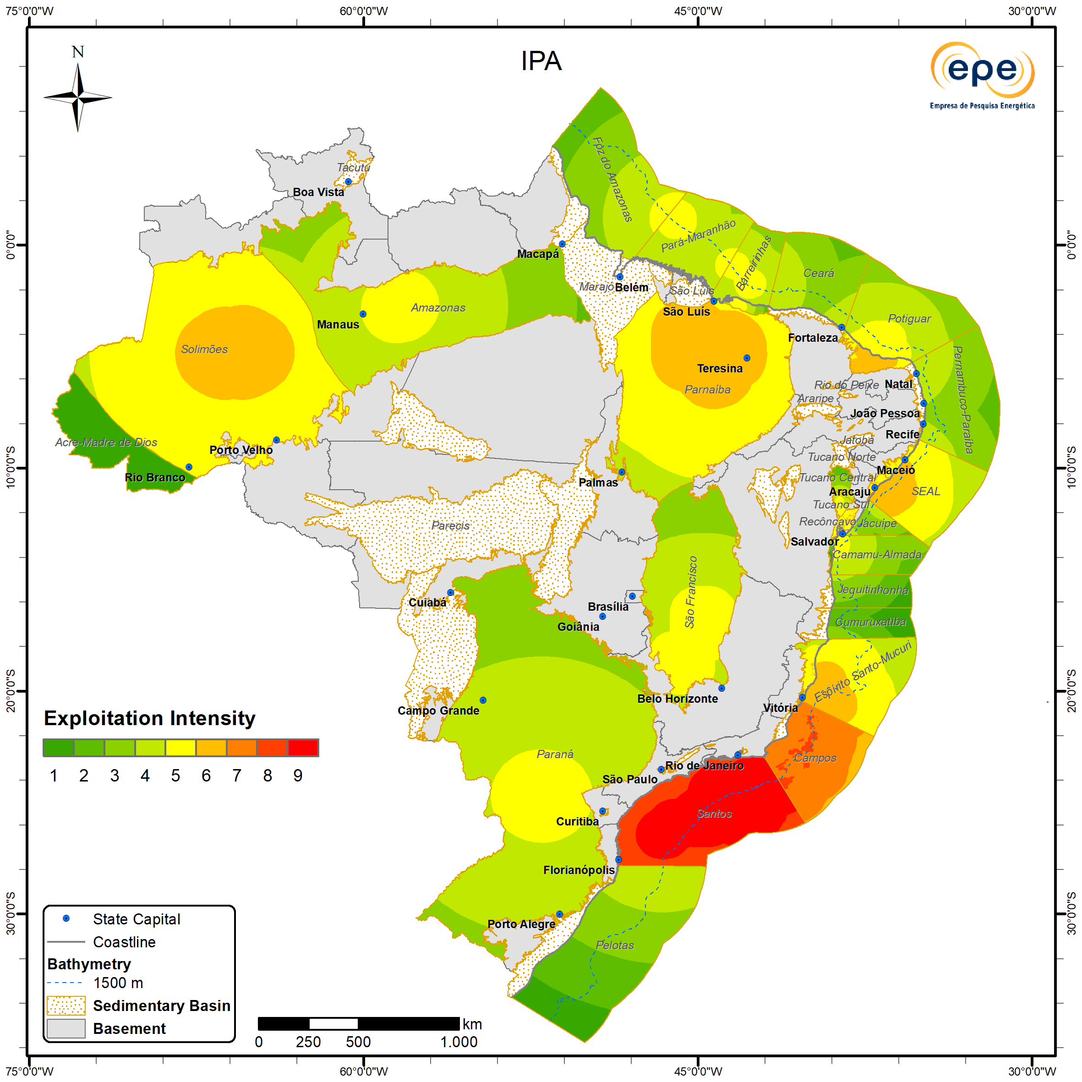
2. Exploitation Intensity
Description
Represents the importance of the distance from a given point within a sedimentary basin to an oil or natural gas discovery, whether under evaluation or already commercial.
It takes into account the volumetric size of discovered resources (oil and/or gas) in each basin.
The reference date used is February 28, 2025.
ZNMT 2023-2025

Slide 24
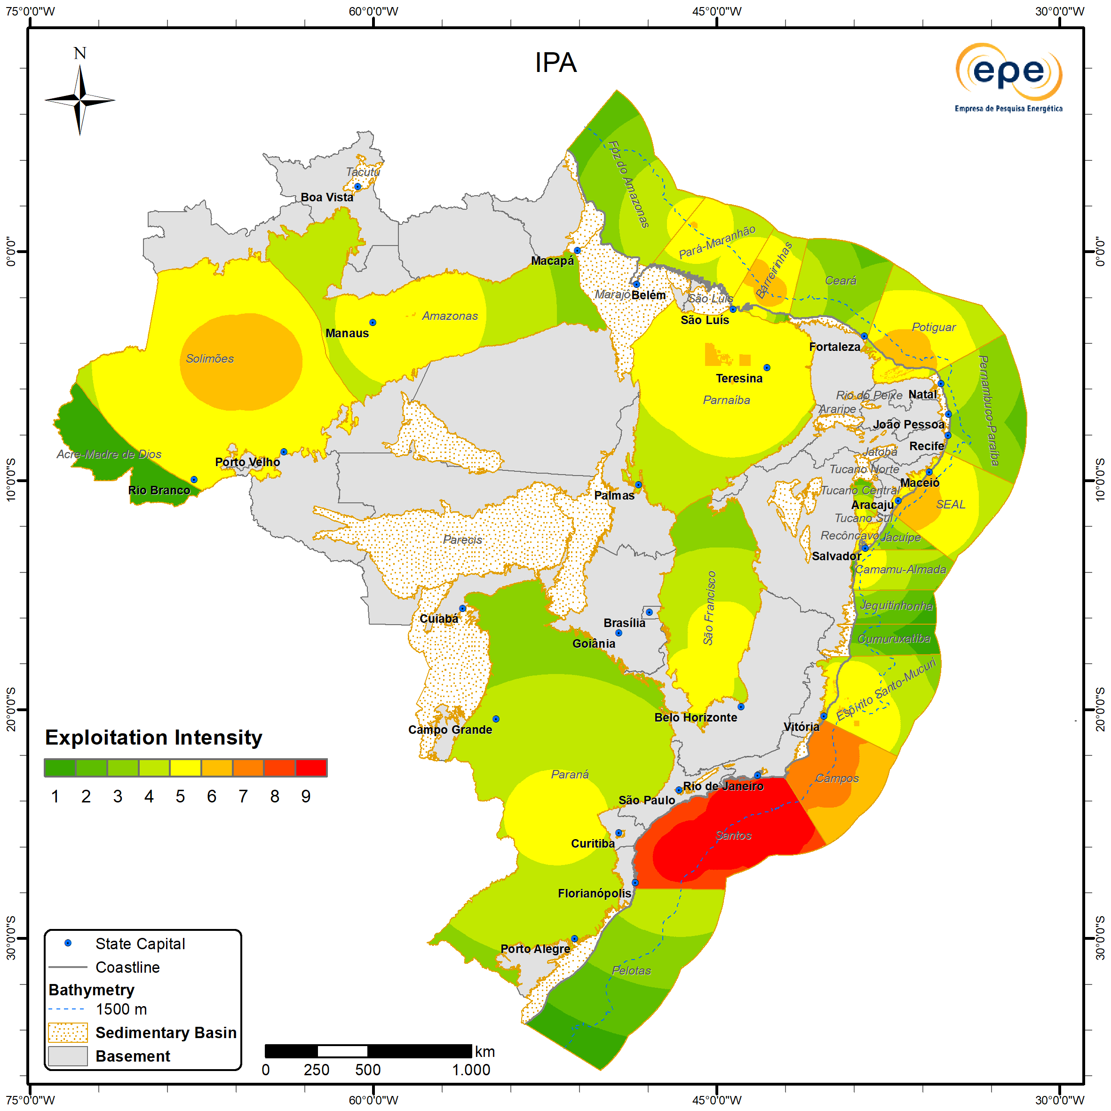
Exploitation Intensity
Updates
The highest importance continues to be observed in the Santos and Campos basins, which are the main producers of oil and natural gas in the country.
The largest increases in importance compared to the 2021–2023 cycle were observed offshore in the Campos and Espírito Santo-Mucuri basins, and onshore in the Parnaíba and Potiguar basins.
Decreases in importance were mainly observed in the Tucano Sul, Barreirinhas (offshore), Pará-Maranhão, Potiguar (offshore), and Amazonas basins.
ZNMT 2021-2023
ZNMT 2023-2025

Slide 25
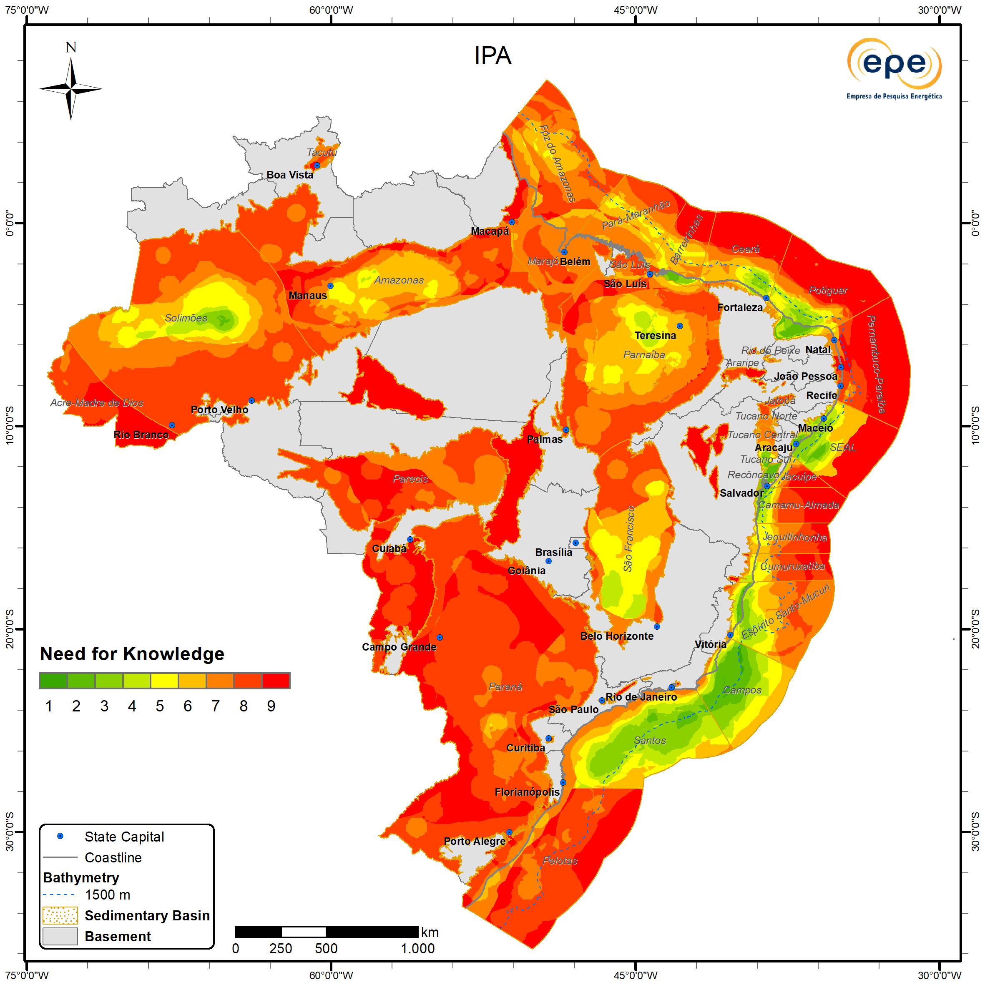
3. Need for Knowledge
Description
Represents the level of uncertainty in the evaluation of regional geological factors that control the formation of oil and natural gas resources within a sedimentary basin.
It indicates the need for additional data acquisition, processing, and/or interpretation.
ZNMT 2023-2025

Slide 26
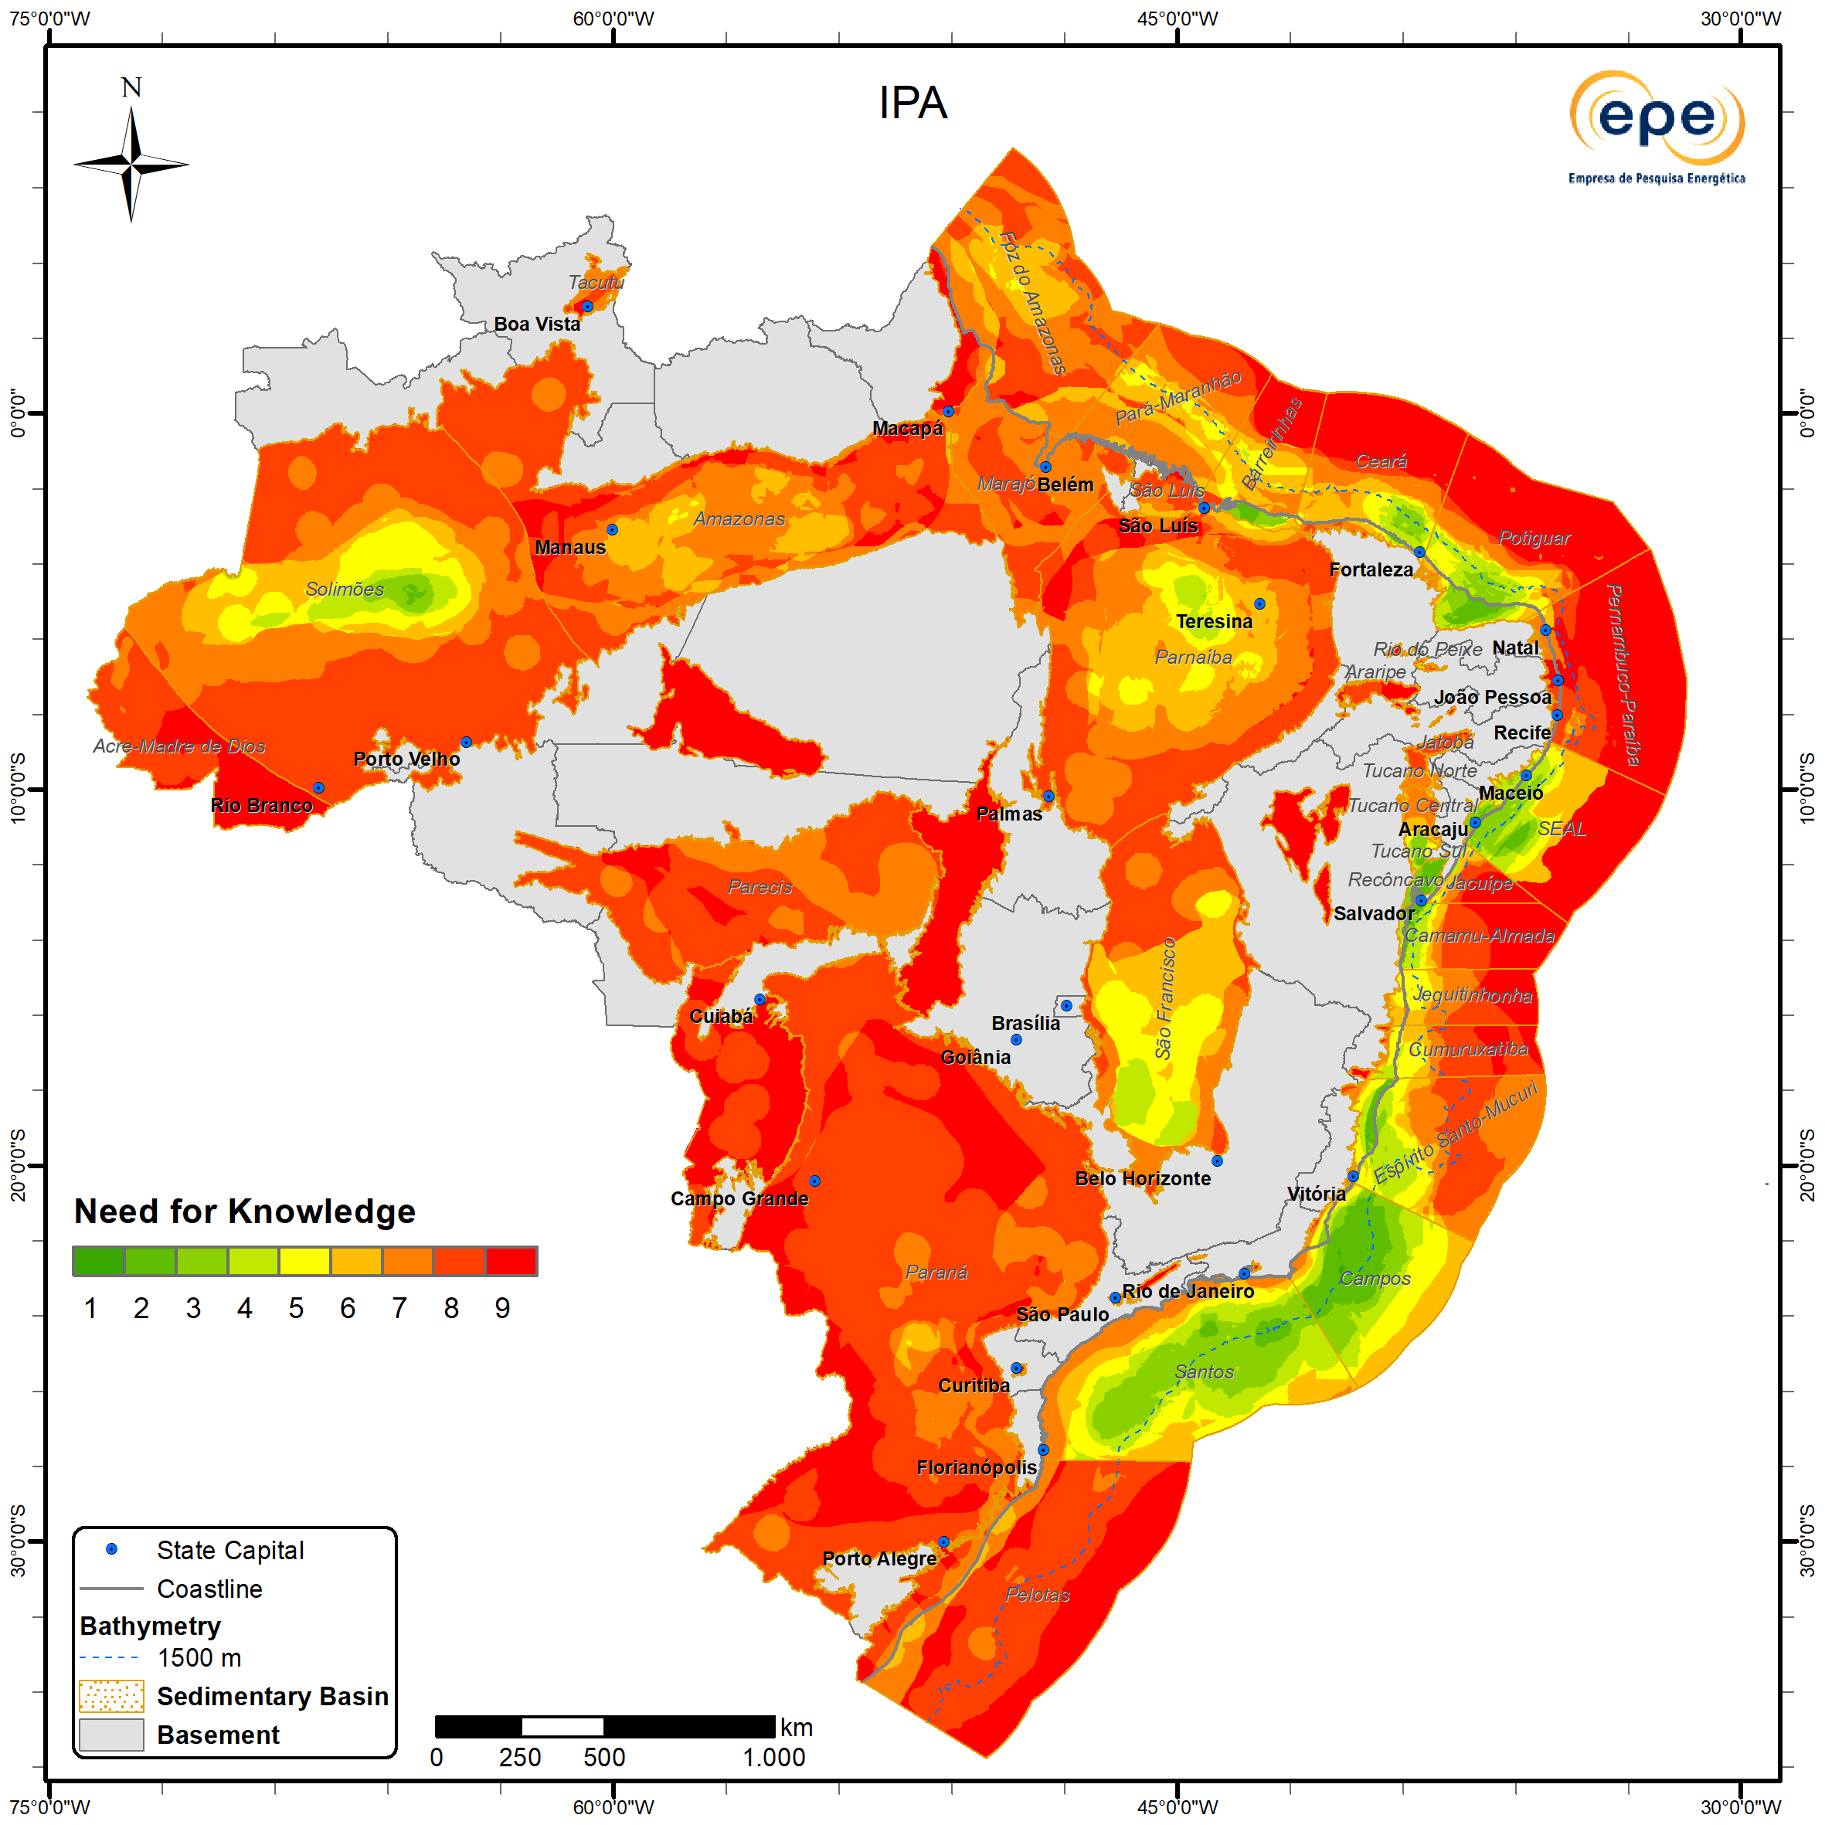
Need for Knowledge
Updates
A decreasing trend in knowledge requirement associated with increased chances of exploration success was observed in the Pelotas, Santos, Campos, Espírito Santo-Mucuri, Jequitinhonha, Parnaíba, Amazonas, and Foz do Amazonas basins.
In contrast, the Parecis Basin, which experienced a reduction in probability in its western portion, showed an increase in knowledge requirement in this area, indicating an additional challenge that may impact hydrocarbon attractiveness.
Regarding data availability, there was a significant improvement in the Amazonas, Parnaíba, and Paraná basinsá.
ZNMT 2021-2023
ZNMT 2023-2025

Slide 27
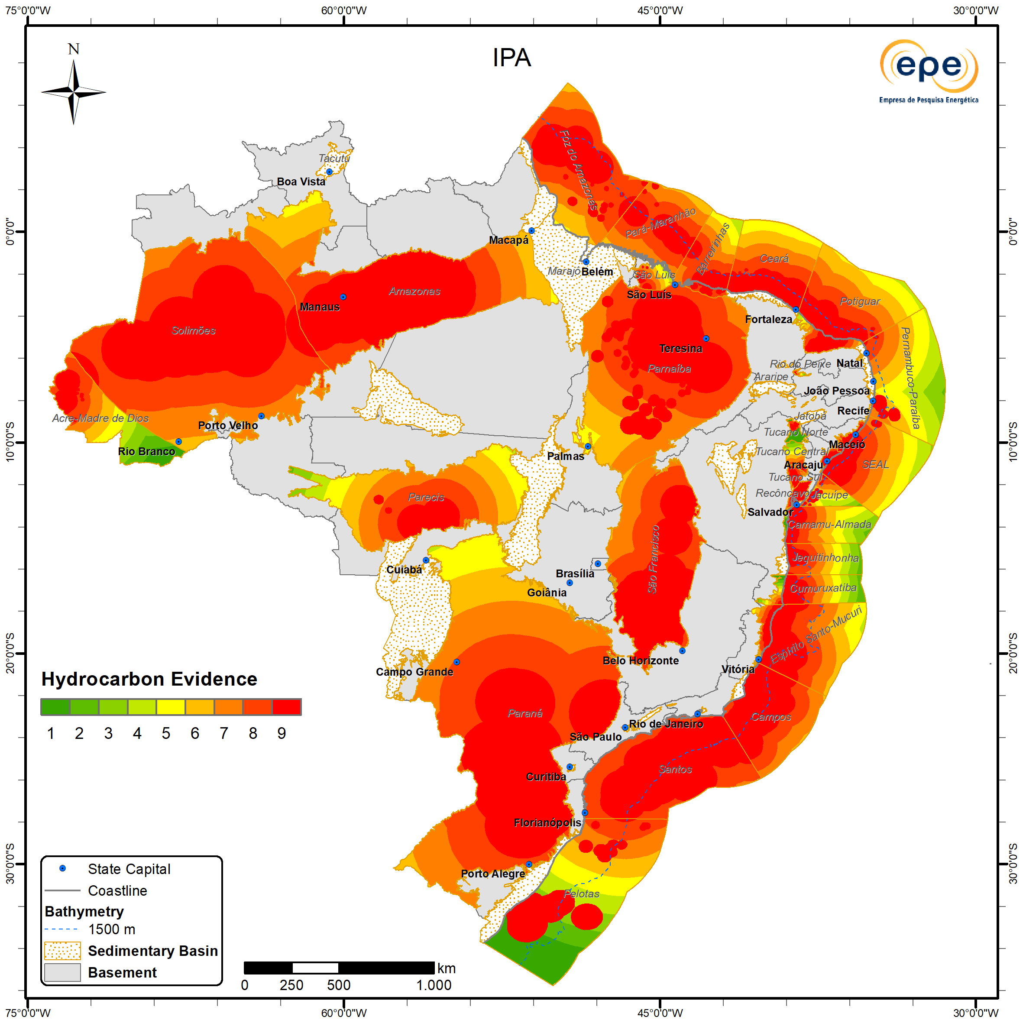
4. Hydrocarbon Evidence
Description
Represents the concept that areas located outside oil or natural gas accumulations, whether under exploratory evaluation or already commercial (fields), that are close to indications or confirmed occurrences of hydrocarbons are more important, in direct proportion to this proximity.
Although most of the Brazilian sedimentary area shows evidence of hydrocarbon generation and migration, this does not necessarily guarantee the existence of commercial accumulations.
Destaques ZNMT 2023-2025
ZNMT 2023-2025

Slide 28

Hydrocarbon Evidence
Updates
Lower importance values were identified in the southernmost portion of the Pelotas Basin and in the distal areas of the Cumuruxatiba, Jequitinhonha, Camamu-Almada, Jacuípe, and Pernambuco-Paraíba basins.
Additional areas with reduced importance include the easternmost portion of the Acre-Madre de Dios Basin, the Rio do Peixe Basin, and the western and eastern extremes of the Parecis Basin.
No importance has been assigned to date for the Bragança-Vizeu, Marajó, Tacutu, Jatobá, Alto Tapajós, Araripe, Bananal, Lençóis, Irecê, Pantanal, and Taubaté basins.
Microseepage occurrences in the Tucano Norte Basin have increased its importance.
ZNMT 2021-2023
ZNMT 2023-2025

Slide 29
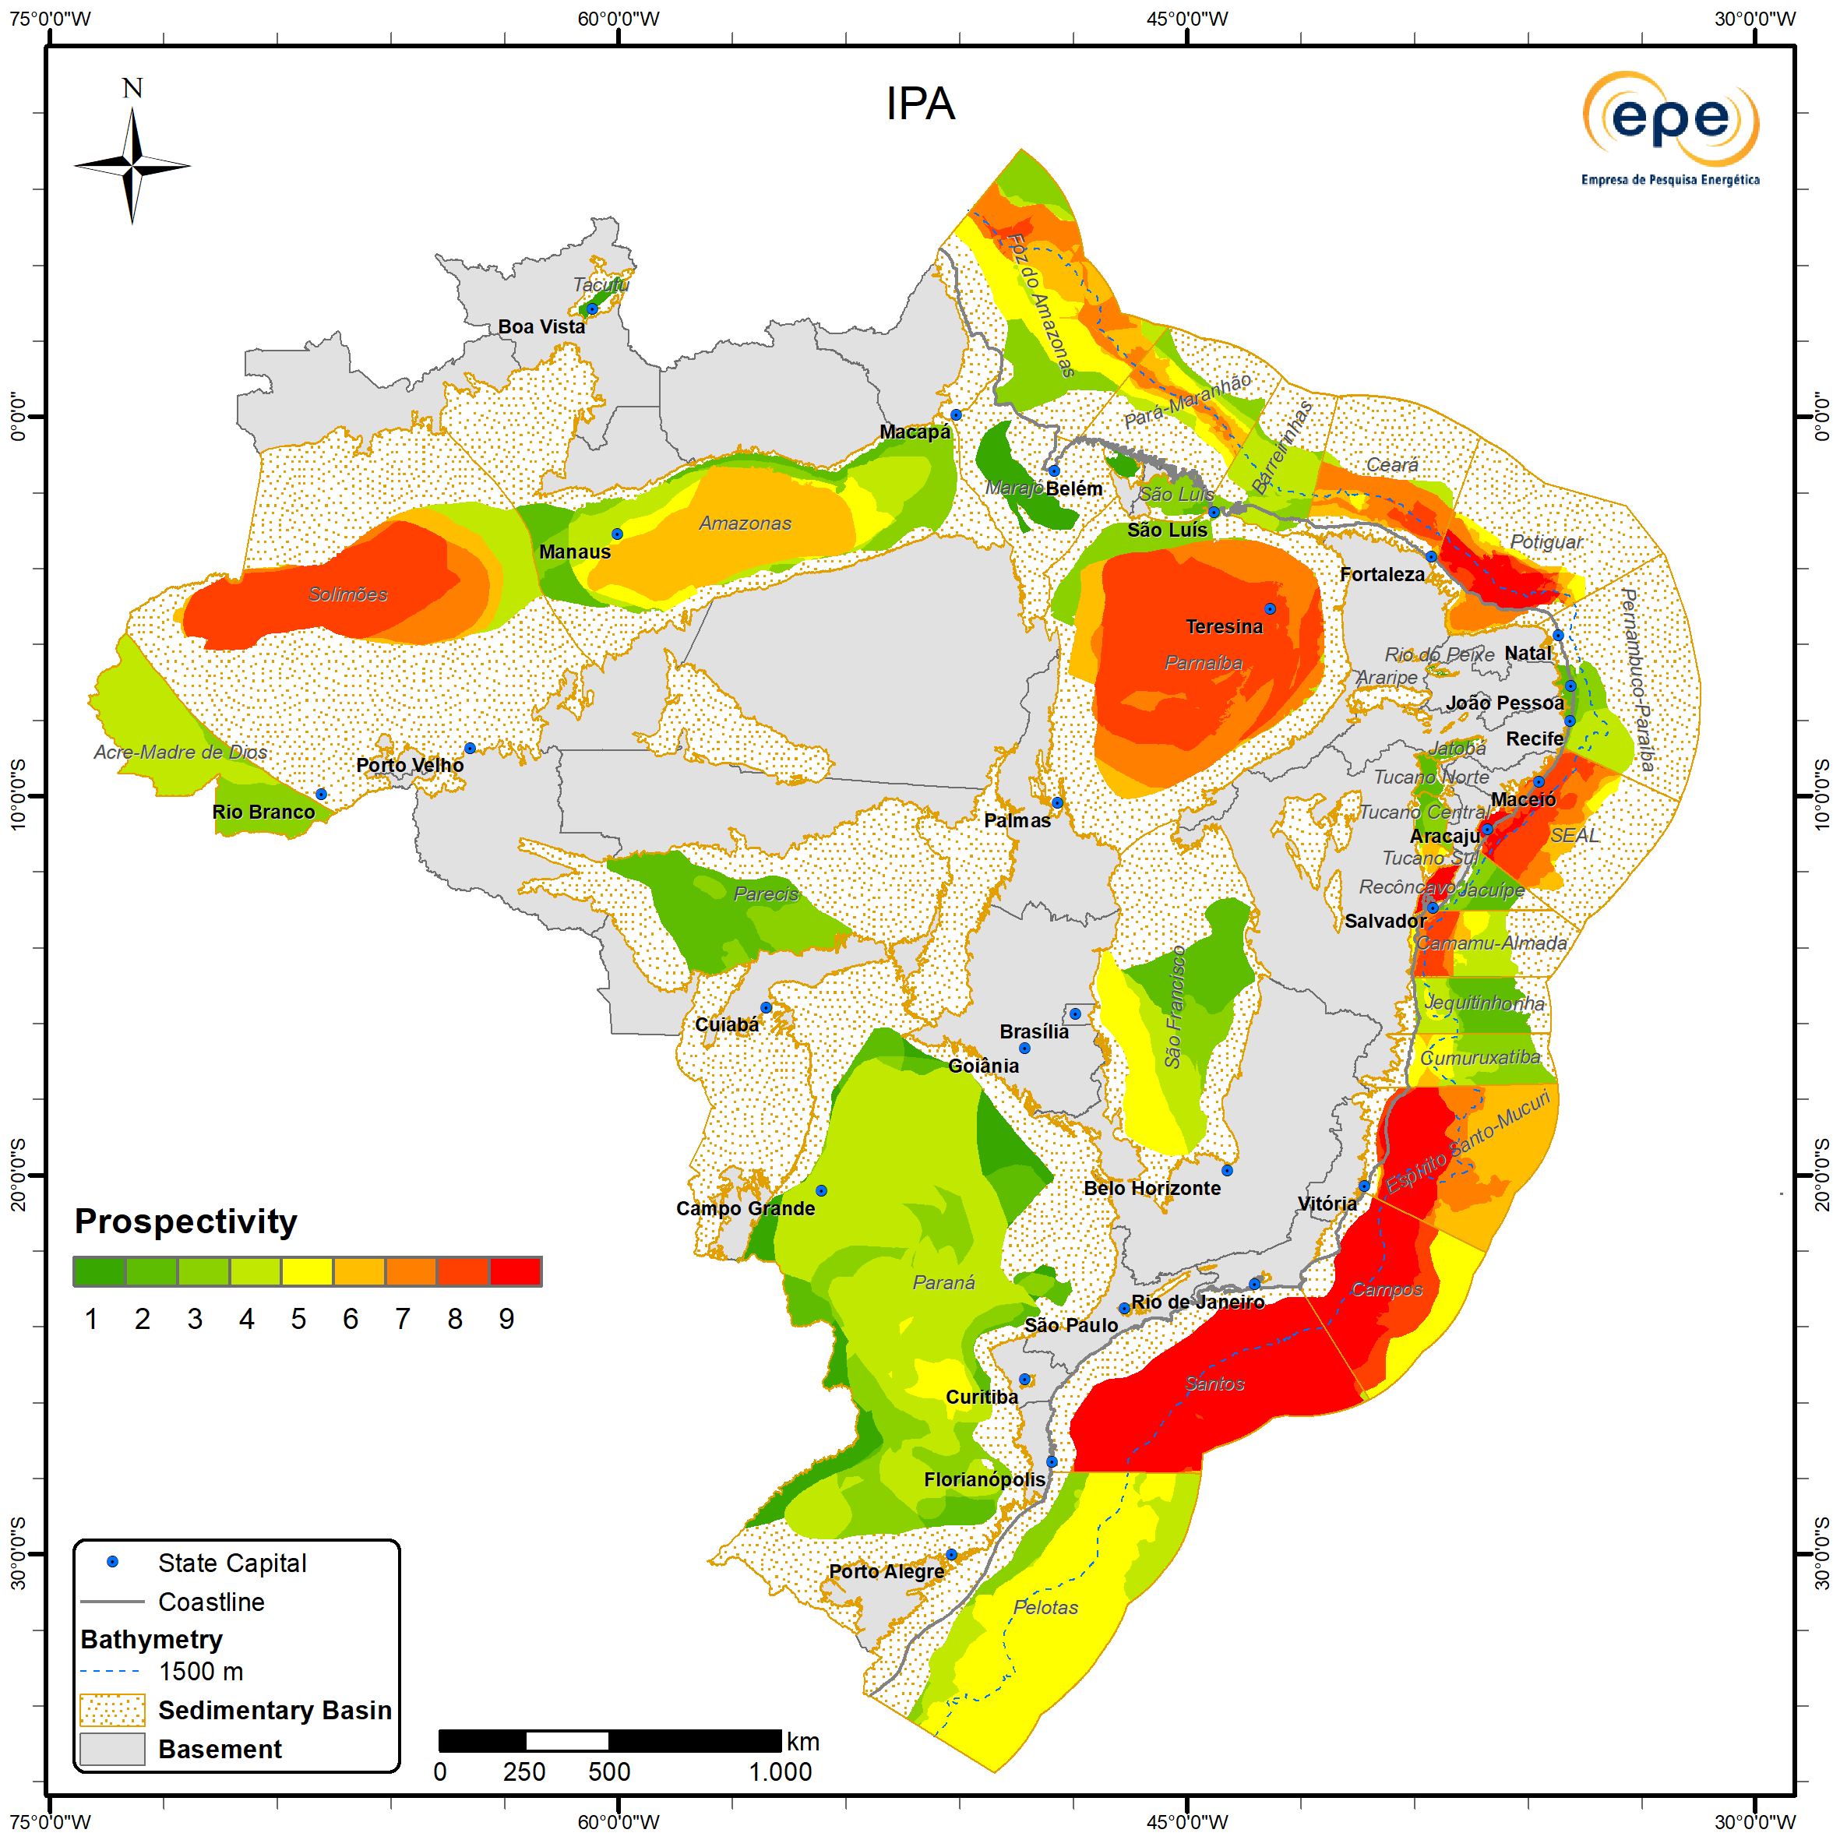
5. Prospectivity
Description
It represents the combination of information regarding the exploratory success probability of an area together with the estimated volumetric size of undiscovered oil and gas resources in sedimentary basins.
ZNMT 2023-2025

Slide 30
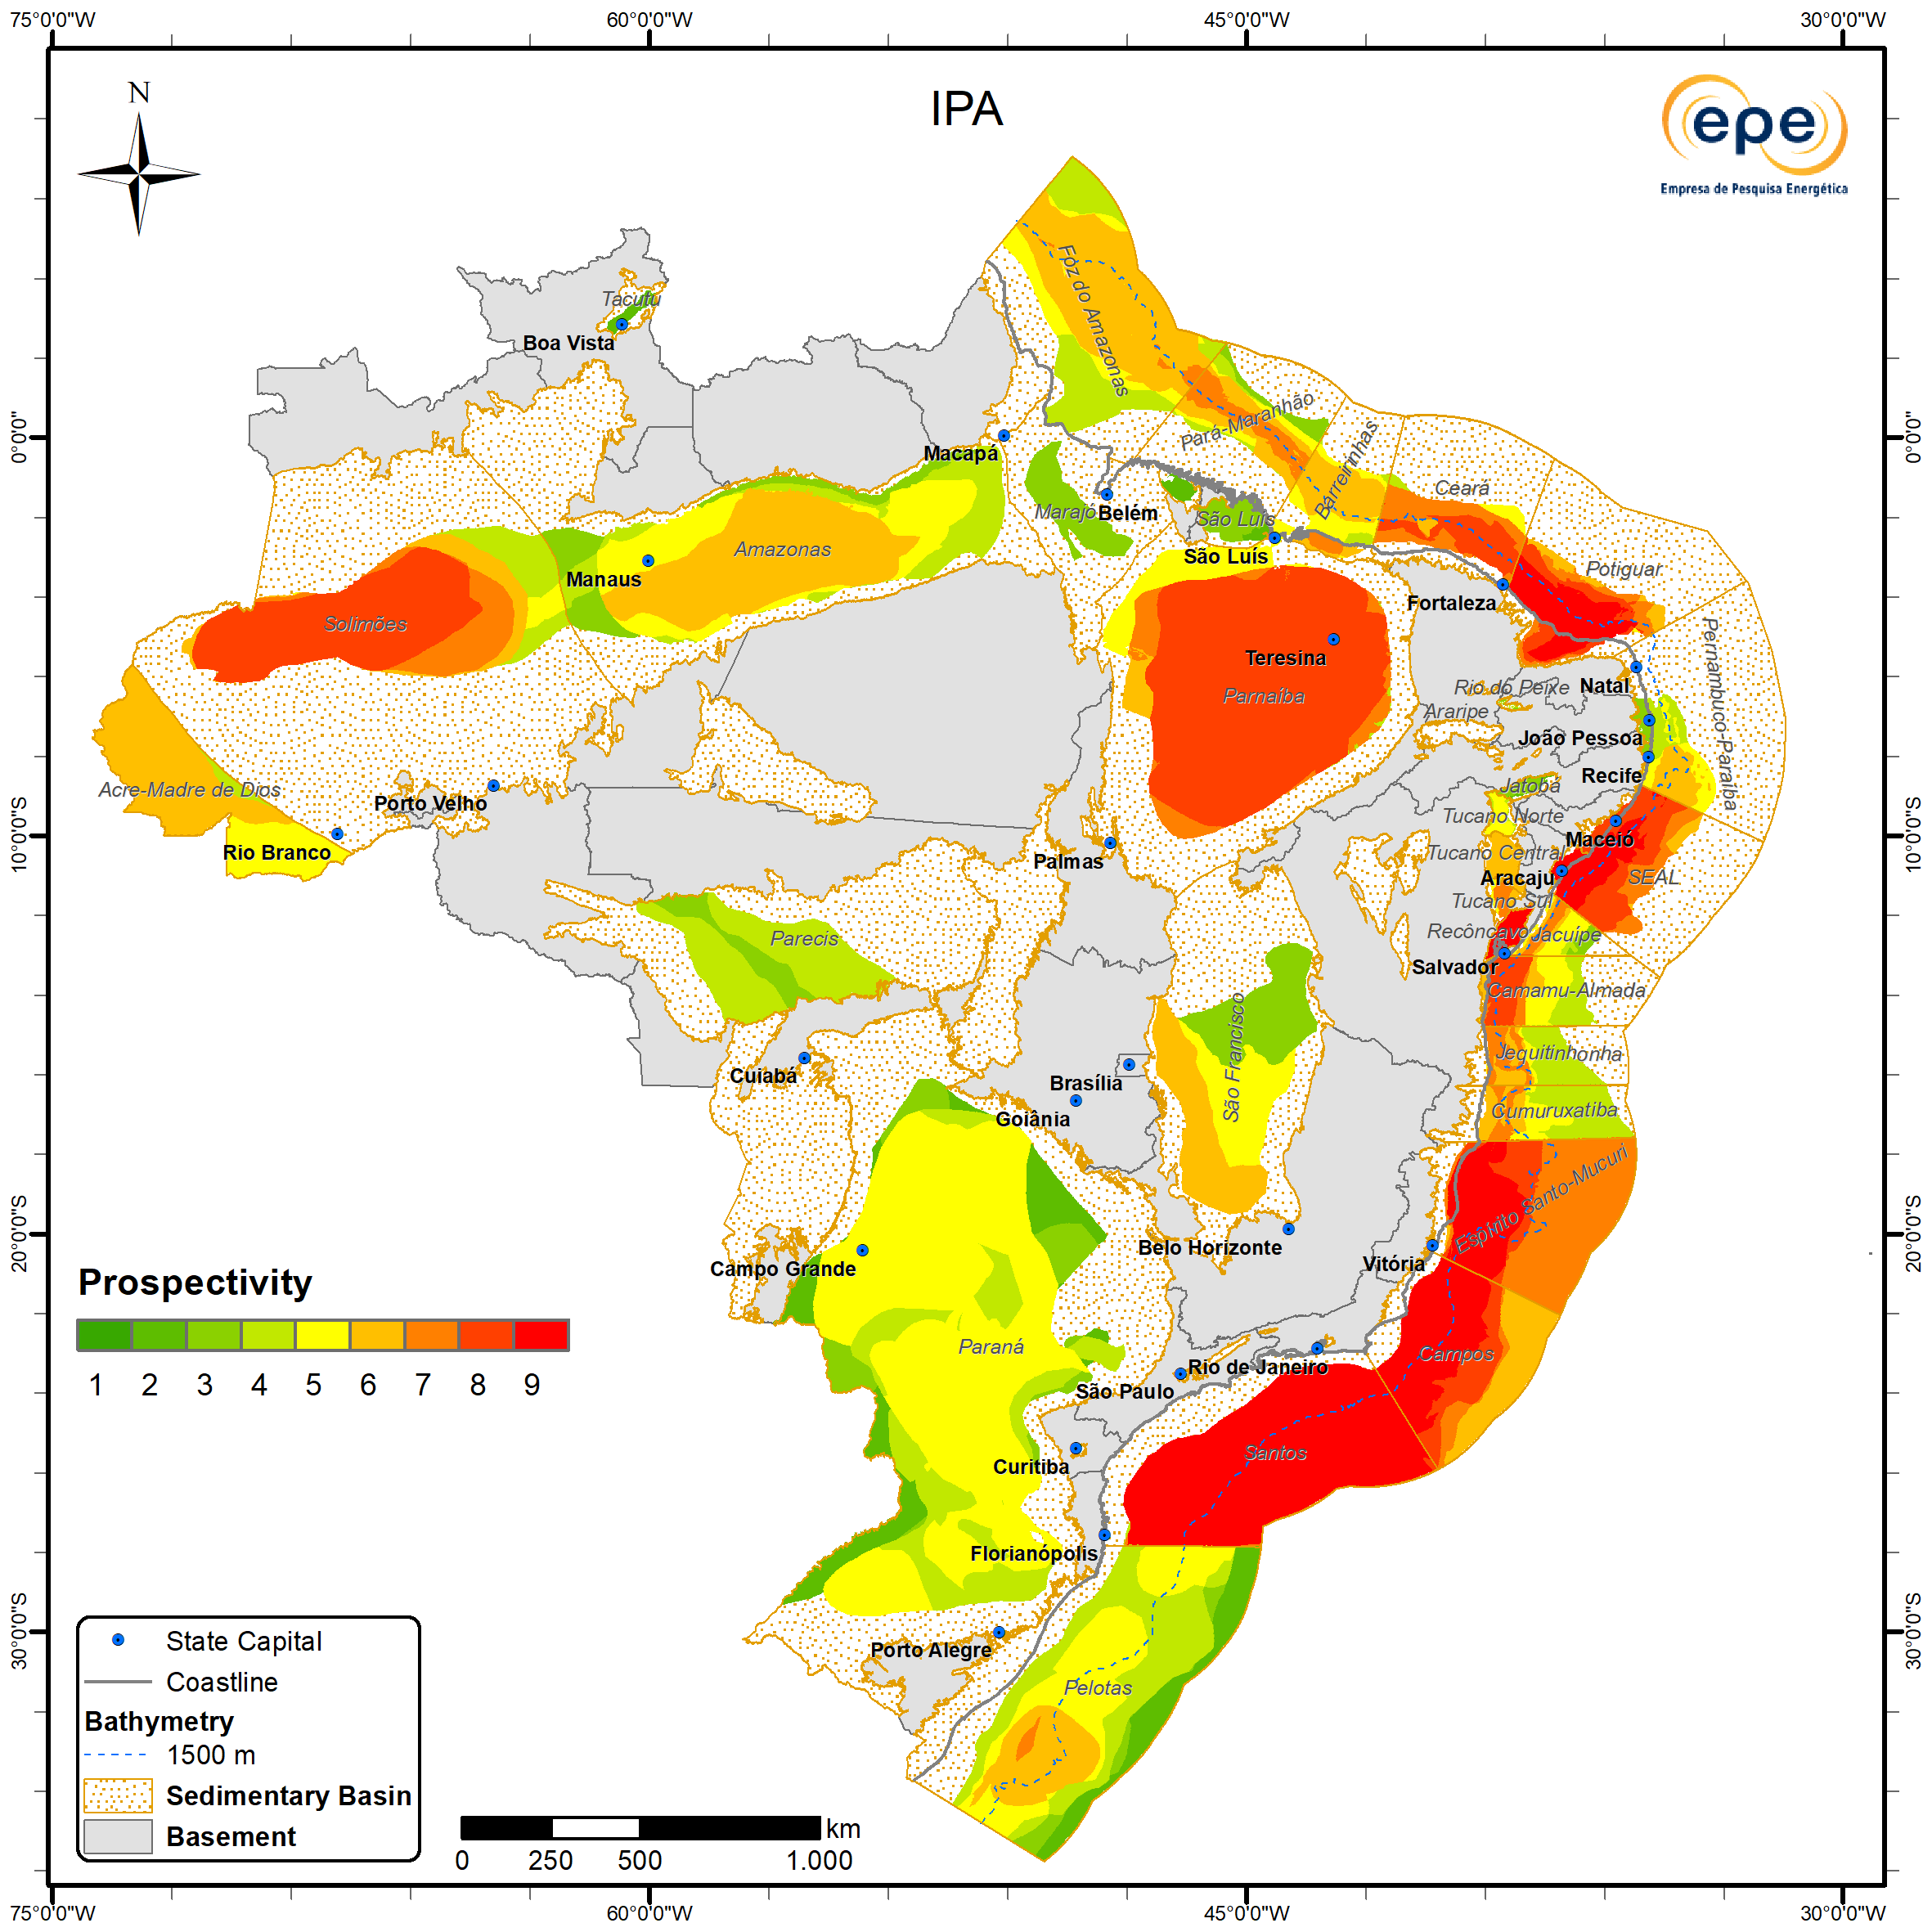
Prospectivity
Updates
The highest prospectivity occurs in producing basins, with several fields and discoveries already made, where geological risks are relatively lower. Highlights include the Santos, Campos, Espírito Santo-Mucuri, Solimões, Parnaíba, Recôncavo, Potiguar, SEAL, Sergipe, Alagoas, Ceará and Camamu-Almada basins (proximal offshore and onshore portion).
The northwestern region of the Foz do Amazonas Basin stands out due to advances in volumetric analysis, detailed below. Intermediate levels of importance are once again recorded offshore in the Pará-Maranhão, Barreirinhas, Cumuruxatiba and Pelotas basins. Onshore, moderate expectations occur in the Amazonas, São Francisco (southern/ southwestern portion), Paraná and Tucano Sul basins.
ZNMT 2021-2023
ZNMT 2023-2025

Slide 31
Improvement of Volumetric Assessment
Since 2021, EPE’s E&P team has been advancing the evaluation of primary seismic and well data through the project “Enhancement of Basin Analysis and Petroleum System Modeling” (AE-0217.03.DPG.SPG). Recognizing the need to improve volumetric estimates, particularly for frontier basins, the group engaged a specialized consultancy throughout 2023, which provided workflows for the volumetric assessment of Brazilian sedimentary basins. These workflows were implemented in the evaluation of the volumetric potential of the Amazonas and Foz do Amazonas basins, with the latter having its results published in EPE (2024). In 2025, the results of the volumetric estimation of prospective (undiscovered) resources in the Parnaíba Basin were published (CARVALHO; D’ALMEIDA; ZALAN, 2025).
Both published assessments were conducted based on the identification and characterization of conventional exploration opportunities (SPE, 2001). Although an exploration opportunity is constrained to a structure capable of containing a hydrocarbon accumulation within a reservoir interval, the charge and retention elements of the petroleum system were also evaluated to estimate the probability of discovery (COSTA; ZALAN; DE MENDONÇA NOBRE, 2013; ROSE, 2001).
The potential volume of prospective resources for a given play within a basin is assessed as the sum of the volumes of the identified exploration opportunities, weighted by their probability of discovery (CARVALHO; D’ALMEIDA; ZALAN, 2025). This evaluation depends on the quality and coverage of seismic data across the basin’s areal extent. Therefore, areas without seismic coverage, such as the Parnaíba Basin, or those still under evaluation, such as the Foz do Amazonas Basin, had their volumes estimated through extrapolation for publication purposes.
Finally, starting in this cycle, EPE addresses a need identified in 2022 by incorporating the volumetric results from its internal basin analysis enhancement project into the estimates of oil and gas volumes in undiscovered areas, which support the development of the Prospectivity IPA. In this cycle, the Limoeiro play (Foz do Amazonas Basin) was the first play to be evaluated using this methodology. The volumetric results obtained for the Parnaíba Basin were consistent with those derived from the methodology traditionally applied in the ZNMT and were therefore used primarily for validation. In the short term, new results for the Pelotas Basin, currently under analysis, are expected to be published.

Slide 32
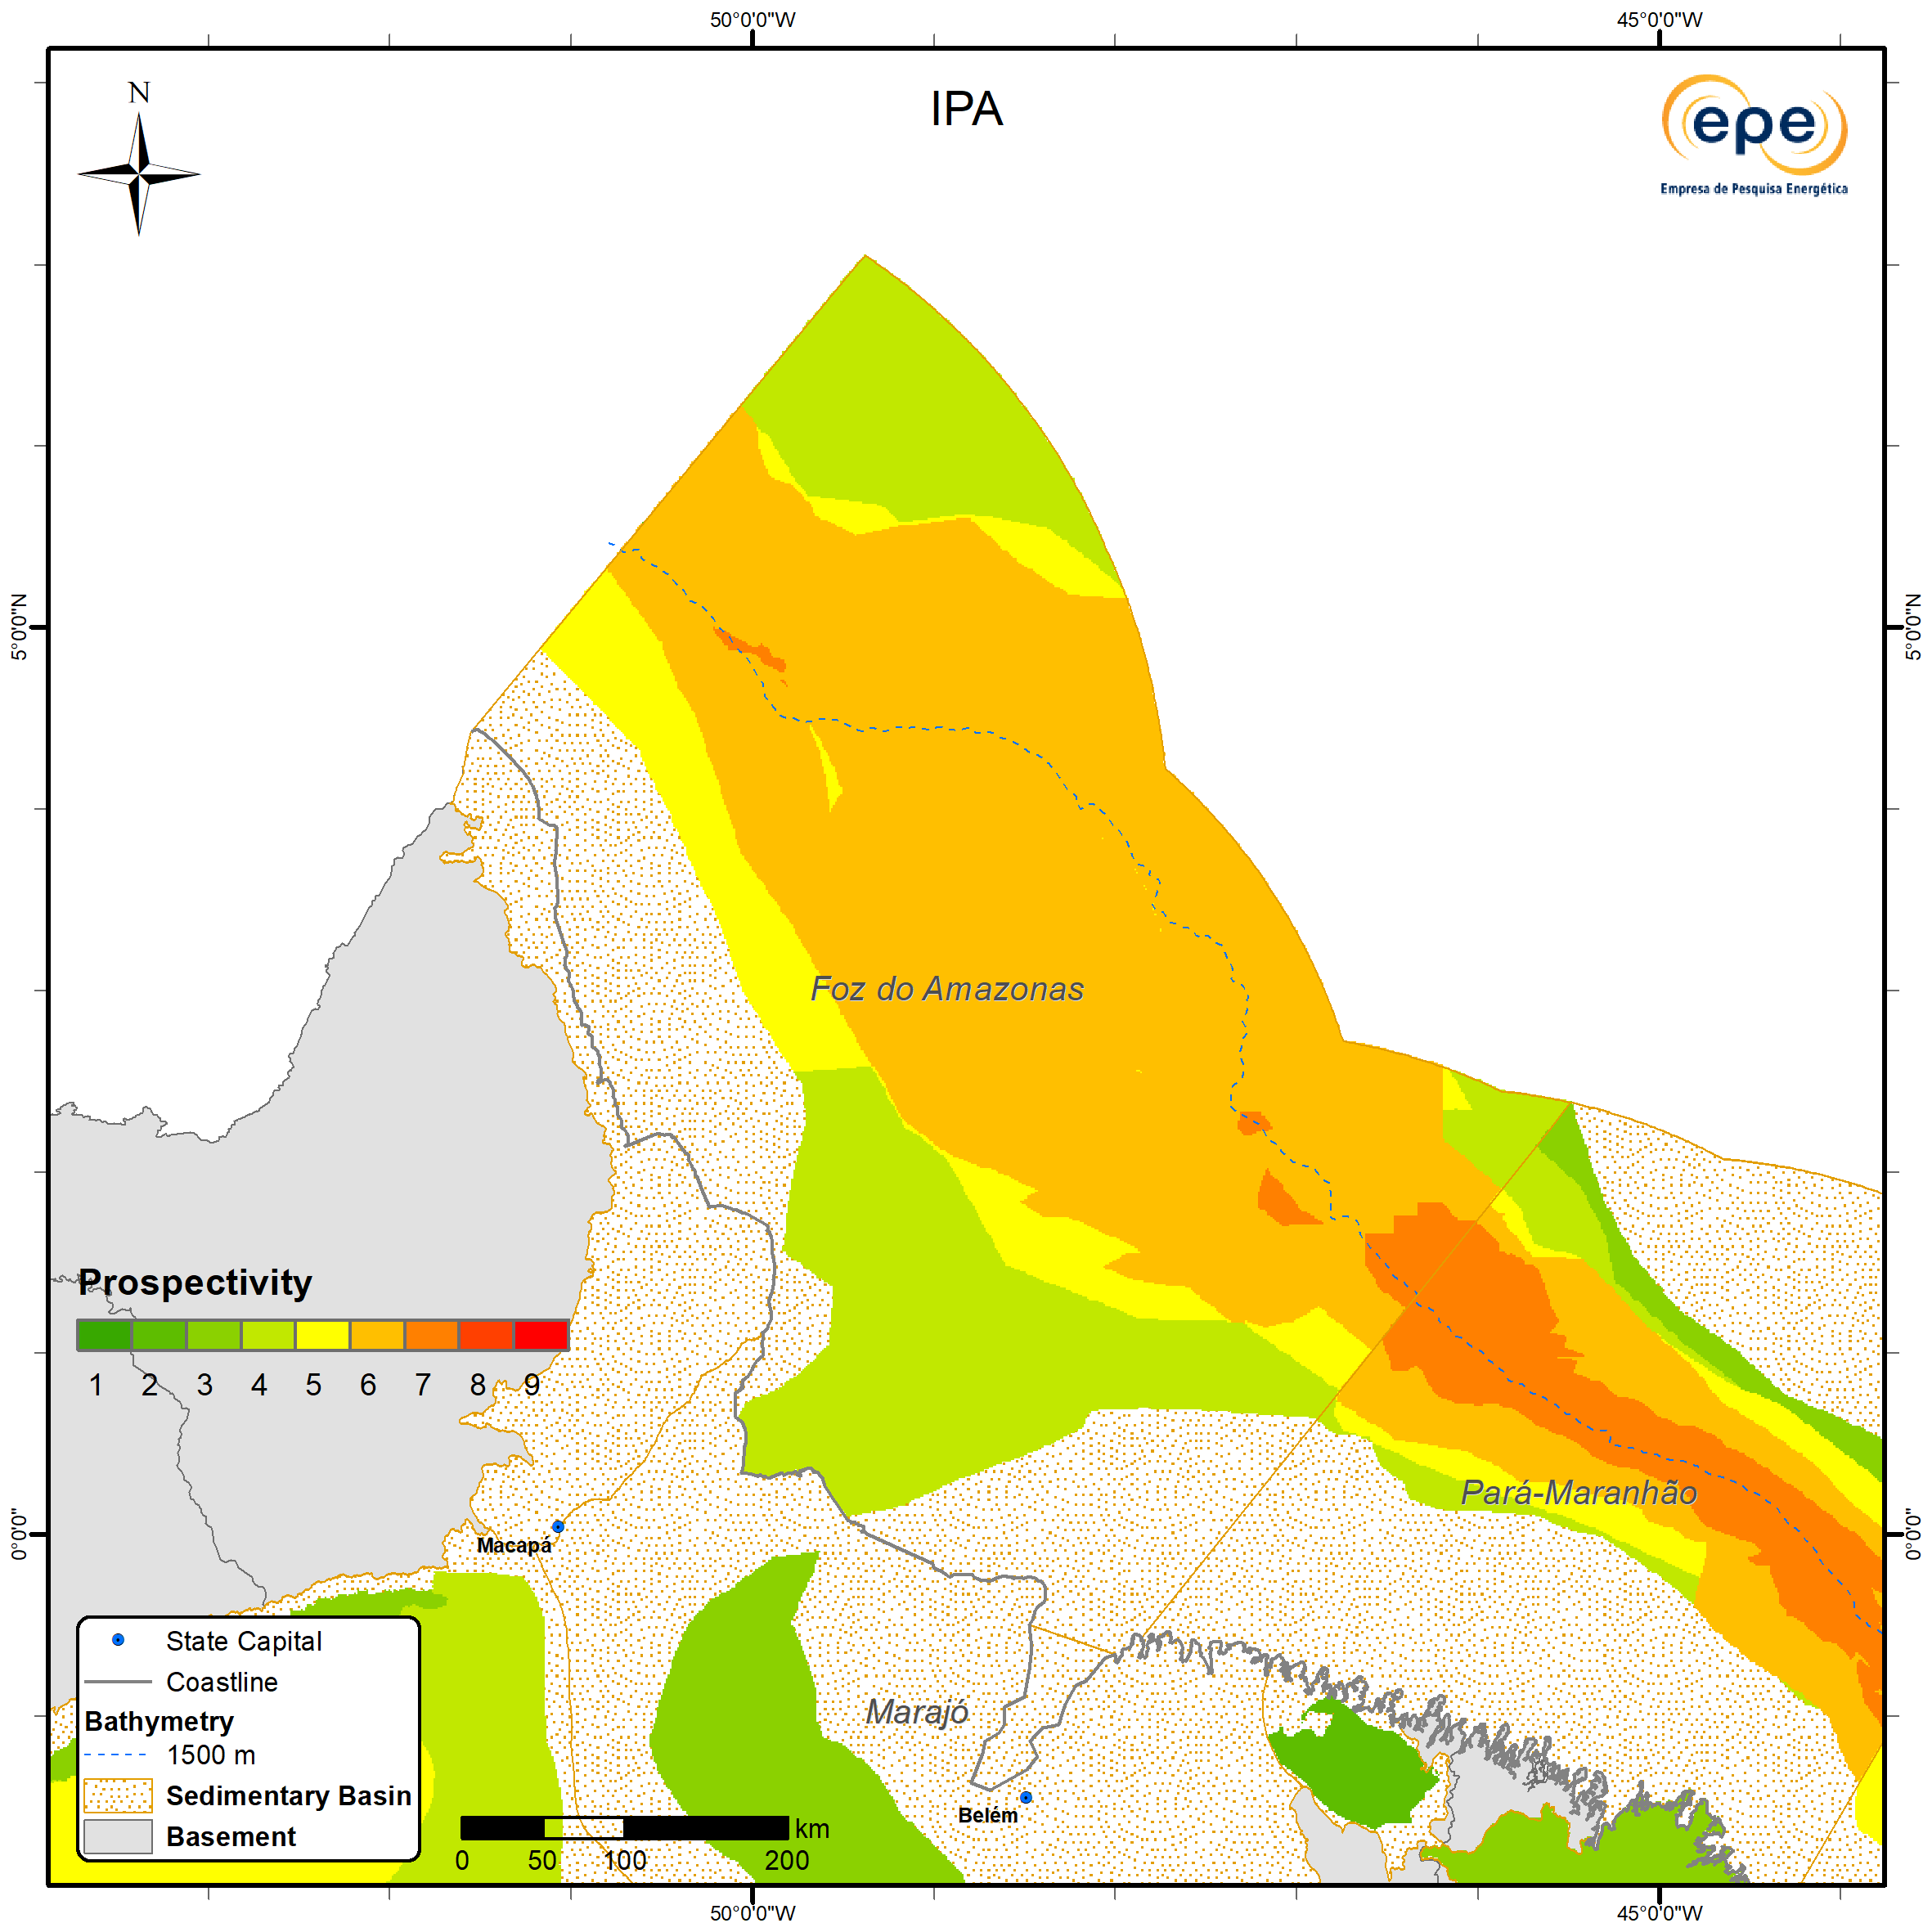
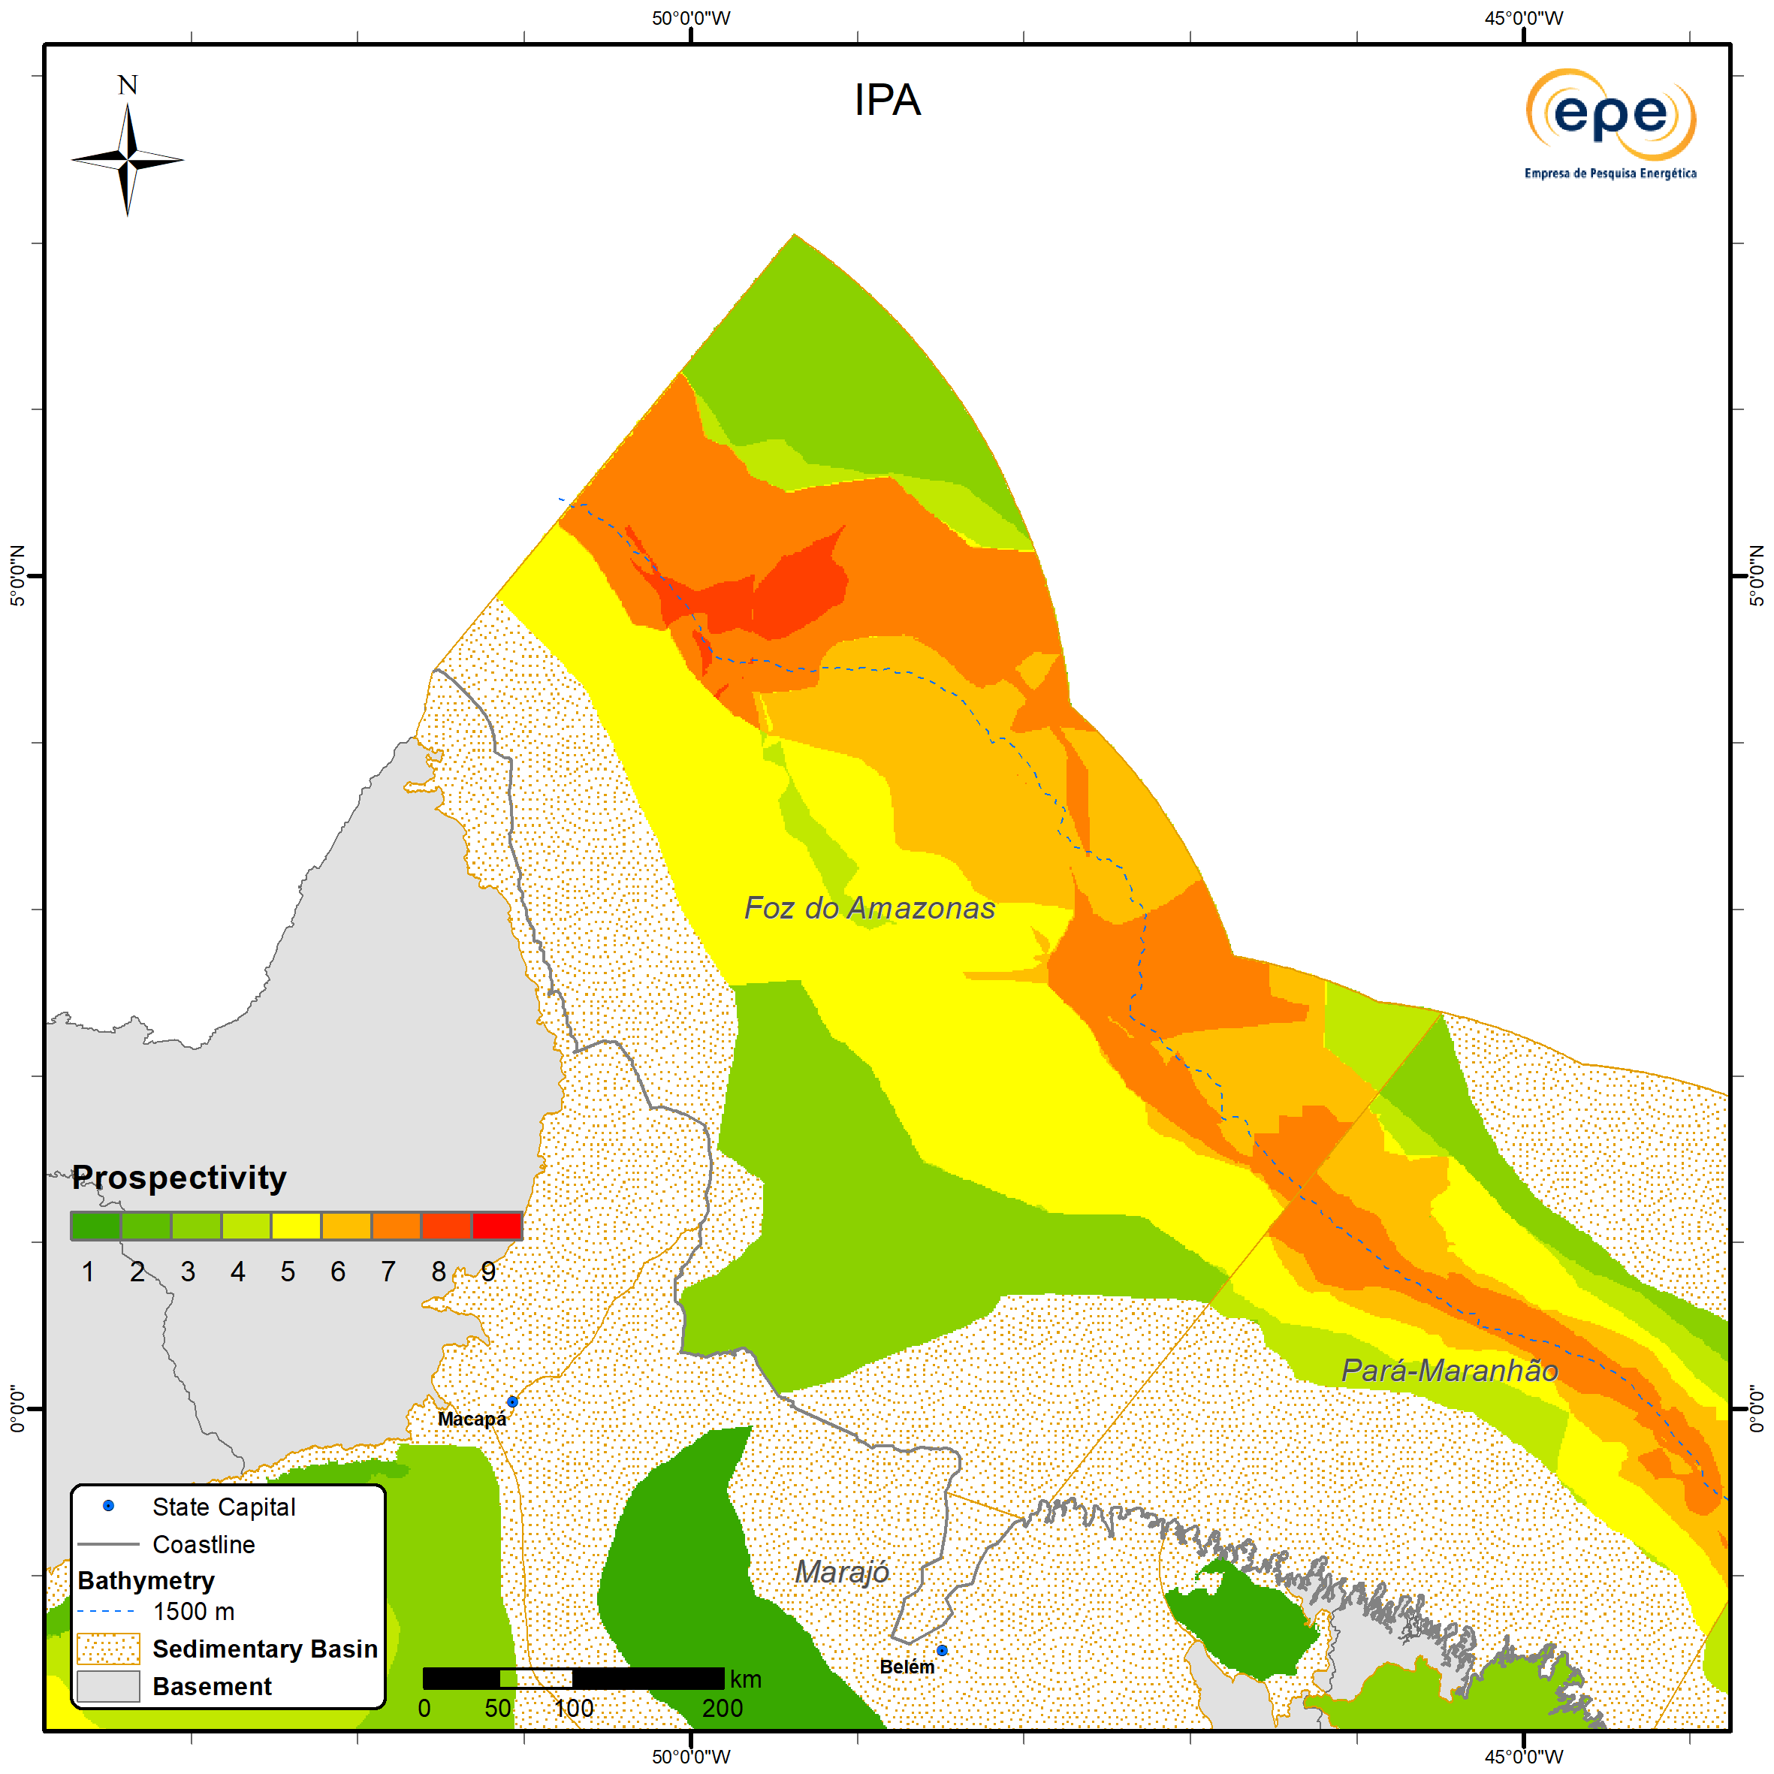
Foz do Amazonas Basin Advances
In 2022, EPE hired a consultancy specialized in the estimation of Hydrocarbon Volume in Place in Brazilian Sedimentary Basins (CT-EPE-032/2022), which, through a robust methodology practiced by the Oil and Gas Industry, proposed workflows to quantify the available oil and natural gas resources through the analysis of geological and geophysical data.This workflow was applied as a case study in the Foz do Amazonas Basin, resulting in the mapping and volumetric study of leads of the Limoeiro play in the northwestern portion of this basin, motivated by the recent and significant oil and gas discoveries in the Stabroek block, in the Guyana-Suriname Basin.A total of 145 2D seismic lines were used, depth-migrated and totaling more than 31,000 km in length, covering almost the entire extent of the Foz do Amazonas Basin located in deep¹ and ultra-deep waters up to the 200 nautical mile limit, where the largest oil accumulations of the Limoeiro play are expected to occur.
In the interpreted seismic lines, high-amplitude reflectors that are laterally continuous and located in the most basal portions of the Limoeiro Formation were mapped, delimiting the occurrence of the Cenomanian–Turonian source rock and its burial. In conjunction with the calculation of the basin’s average thermal gradient, it was possible to estimate the oil window in the study area, as well as the possible hydrocarbon migration pathways. According to ANP (2021), the presence of Aptian and Cenomanian–Turonian source rocks in shallow waters is confirmed, with possible vertical migration, short-distance lateral migration, or direct contact between the source rock and the reservoir.
ZNMT 2021-2023
ZNMT 2023-2025
Regarding the reservoir and trap factors, the distribution of the 57 leads mapped by the consultancy was used to delimit the areas with the highest probability. Thus, the regions of the Amazon Cone and the southeastern part of the basin, as they have not yet been studied by EPE using this methodology, present higher risk for these factors and, at most, intermediate chances for them.
For the next study cycle, the results of the mapping and the application of the volumetric routine for the remaining area of the Limoeiro play will be included.
¹ Águas oceânicas situadas em áreas com lâmina d’água, em geral, acima de 300 metros

Slide 33
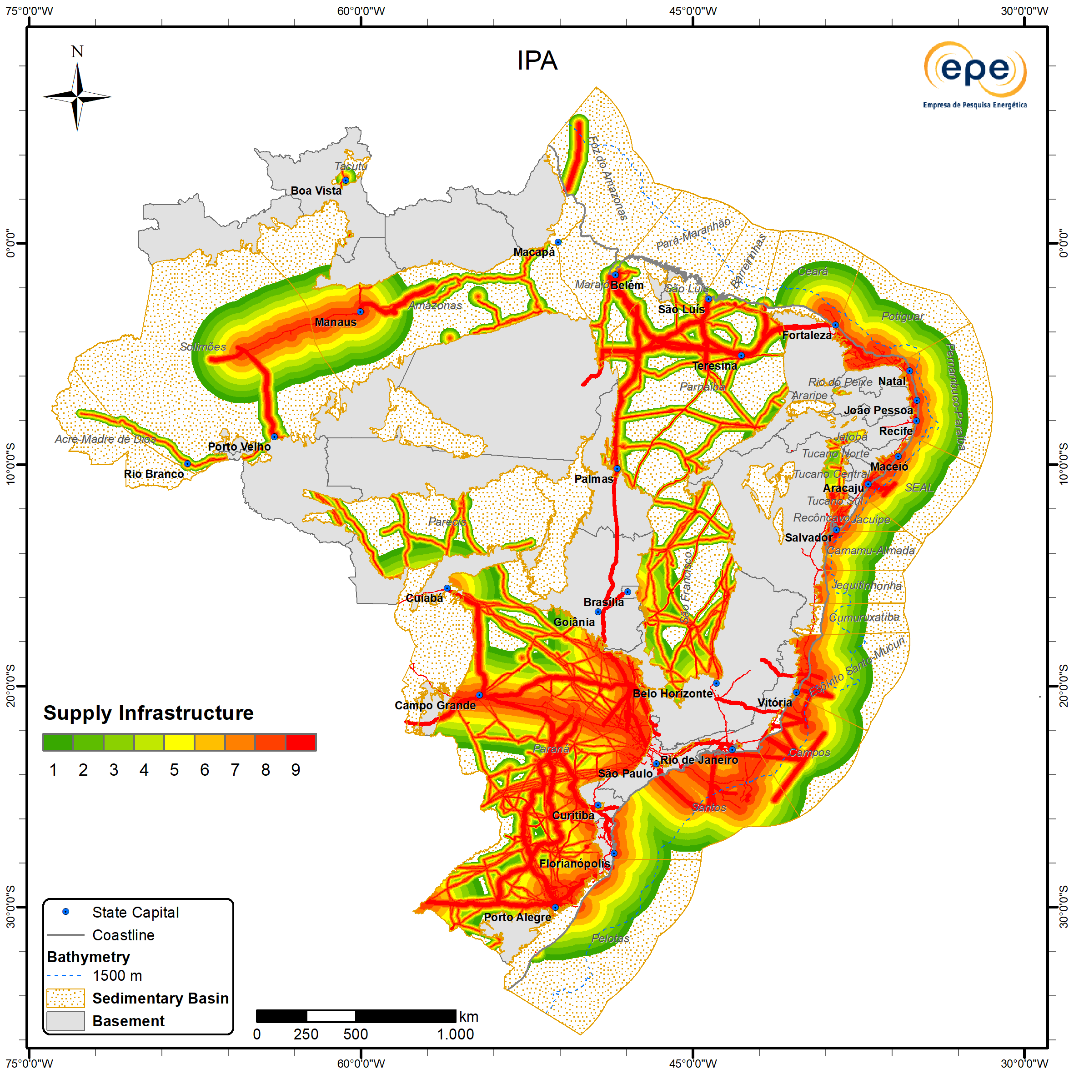
6. Infrastructure
Description
Represents the operational and economic importance attributed to areas closest to facilities that enable society to utilize oil and natural gas production.
Takes into account planned structures and those under construction.
ZNMT 2023-2025

Slide 34
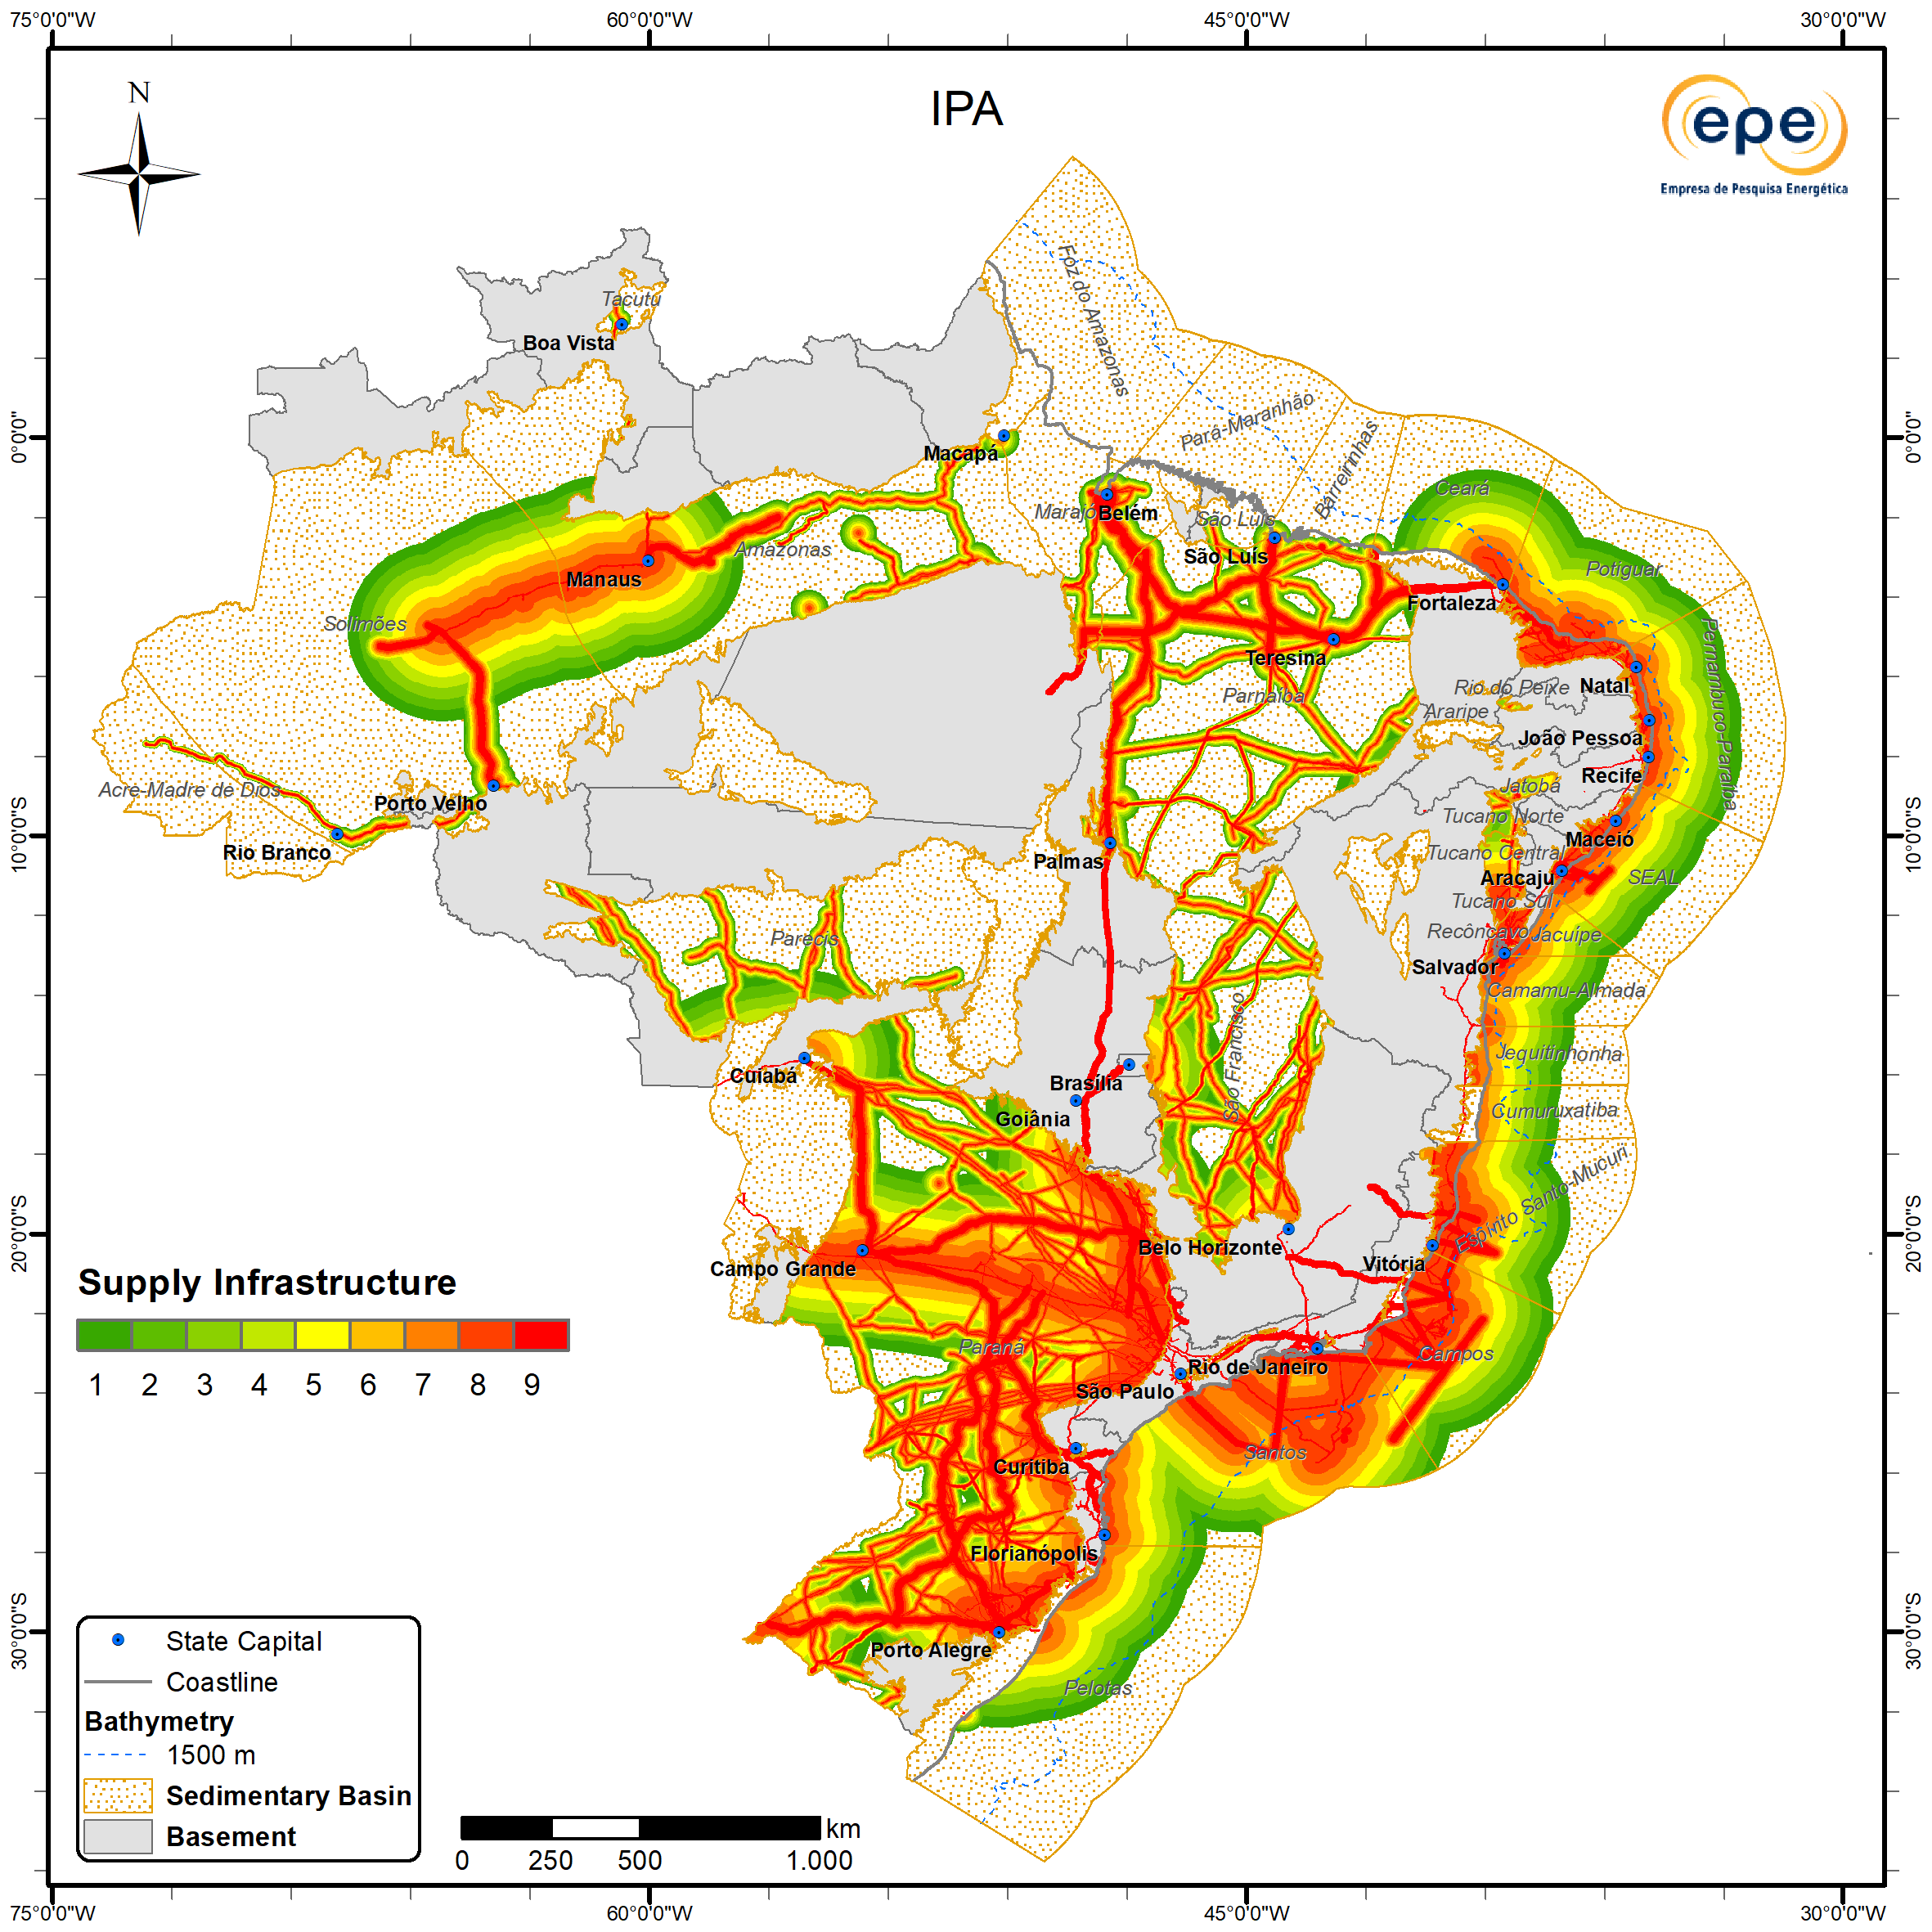
Infrastructure
Updates
Areas of greatest importance continue to be found in the Santos, Campos, Espírito Santo-Mucuri, Recôncavo, Tucano Sul, SEAL, Sergipe, Alagoas, Potiguar, Pará-Maranhão, Solimões, Amazonas, Parnaíba, and Paraná (central portion) basins.
Areas of moderate importance occur in the vicinity of the aforementioned regions, as well as in the Barreirinhas, Ceará, Pelotas (central-northern portion), Camamu-Almada, and Foz do Amazonas basins.
ZNMT 2021-2023
ZNMT 2023-2025

Slide 35
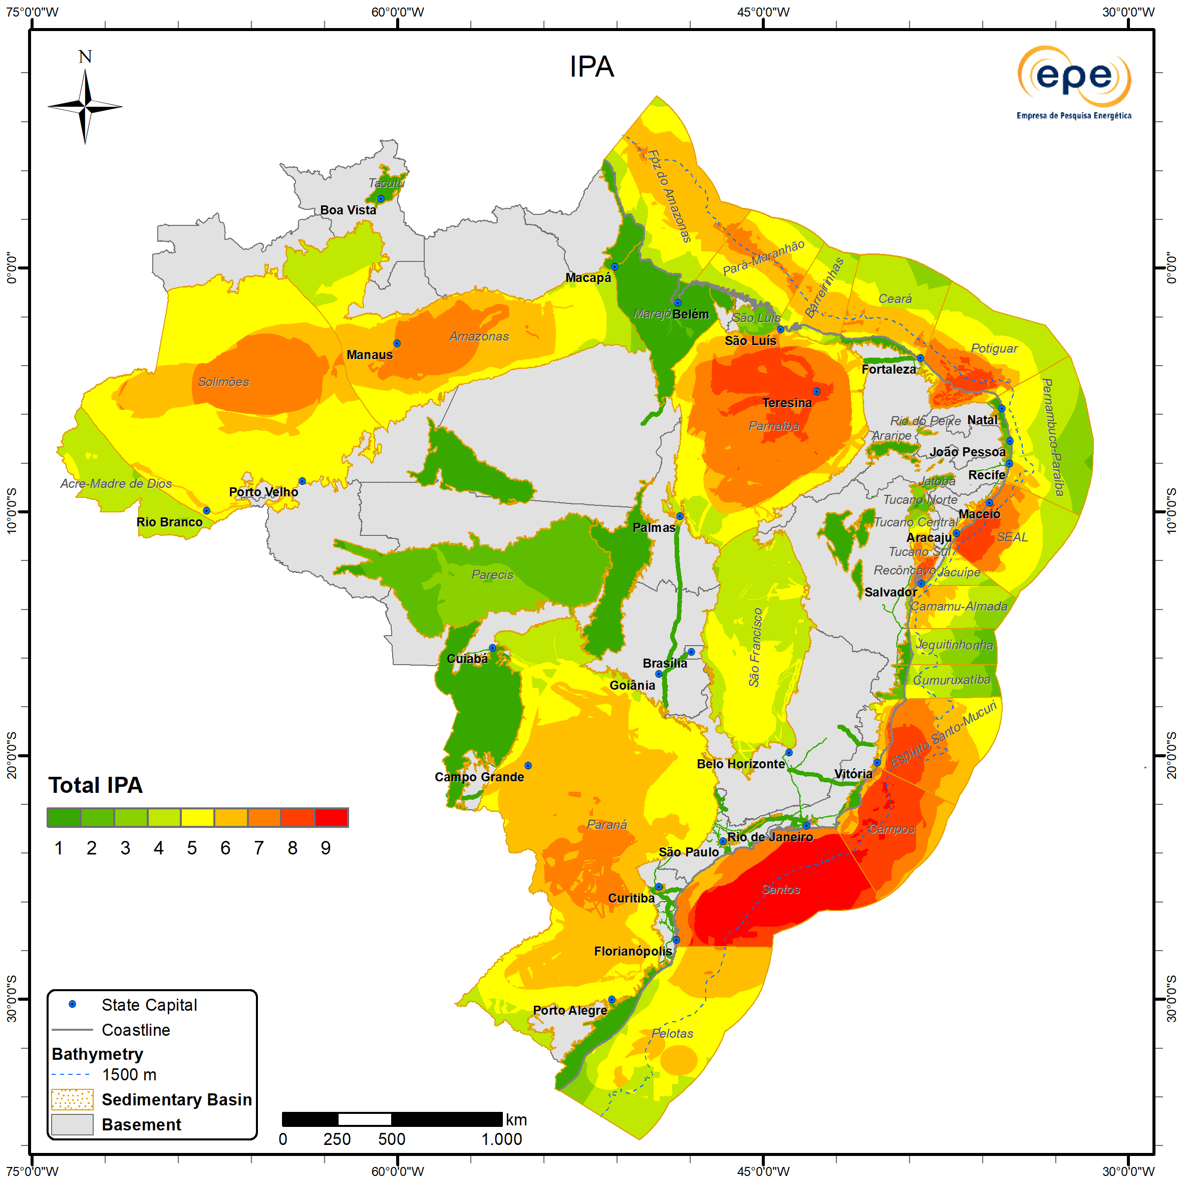
Total IPA
Description
The Total Petroleum Importance (Total IPA) is the result of combining the six described factors, according to the following weight distribution:
Exploitation Intensity = 0.35;
Exploration Activity = 0.20;
Prospectivity = 0.20;
Direct Evidence of Hydrocarbons = 0.15;
Need for Knowledge = 0.05;
(Supply) Infrastructure = 0.05.
ZNMT 2023-2025

Slide 36

Total IPA
Results
Higher importance continues to occur in the Santos, Campos, Espírito Santo–Mucuri, Recôncavo, Tucano Sul, SEAL, Sergipe, Alagoas, Potiguar, Pará–Maranhão, Solimões, Amazonas, Parnaíba, and Paraná (central portion) basins. Areas of moderate importance occur in the vicinity of the aforementioned regions, as well as in the Barreirinhas, Ceará, Pelotas (central-northern portion), Camamu–Almada, and Foz do Amazonas basins.
ZNMT 2021-2023
ZNMT 2023-2025

Slide 37

FOCUS ON THE NATURAL GAS SECTOR

Slide 38
Applying the Methodology with a Specific Focus
Brazilian natural gas has characteristics that make it particularly advantageous for the national energy landscape. Its composition, with a lower content of climate-harmful components, combined with its potential occurrence across various regions of the country, makes it a strategic resource for ensuring energy security, especially during periods of renewable energy intermittency. In addition, its development has a strong capacity to stimulate local value chains, generating public revenues and fostering the development of decarbonization technologies.
With the objective of guiding strategic decision-making for the sustainable use of Brazil’s natural gas potential, integrated analyses were carried out considering both geological and techno-economic aspects, enabling the identification of the relative importance of different areas for the sector based on updated and selected information. This tool is intended to support energy planning, prioritizing actions and investments in regions with greater synergy between supply, demand, and technical feasibility.
Following the first exercise published in the 2019–2021 edition, the original ZNMT methodology was adopted, selecting five major groups of information for the development of the final map:
Existing natural gas availability
Geological favorability for exploration
Existing demand
Sector-relevant infrastructure
Potential areas for underground storage.

Slide 39
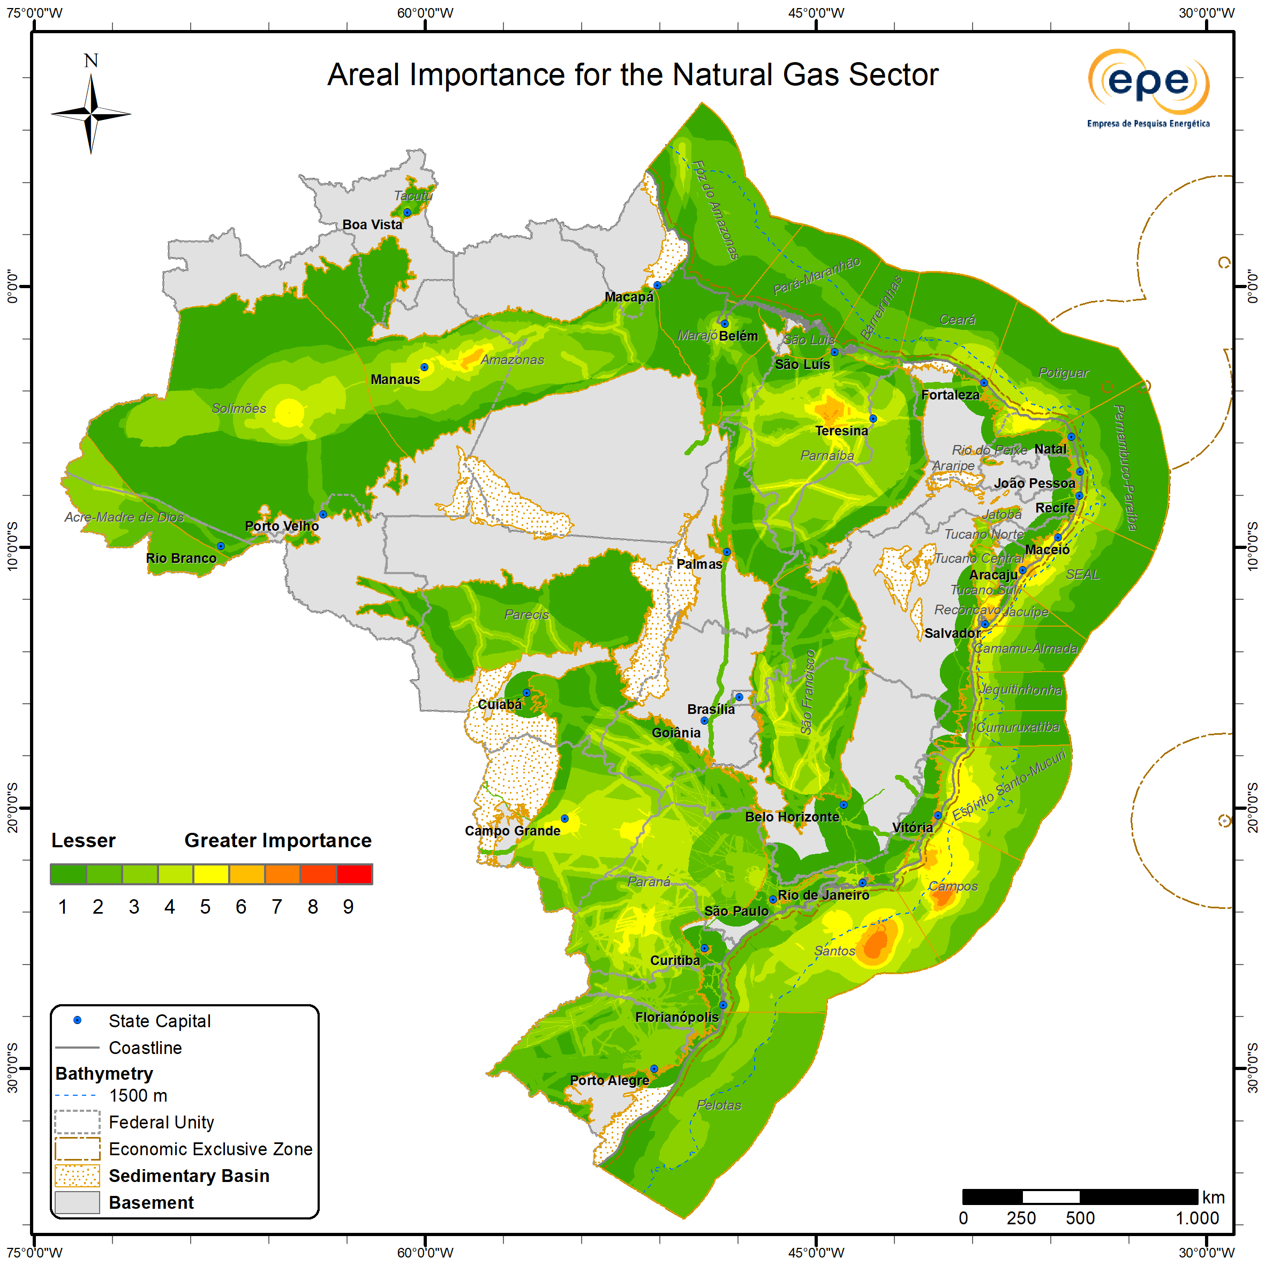
Natural Gas Area Importance
As in the previous two cycles, the Northeast, North, and Southeast regions stand out due to the concentration of favorable conditions for the more immediate development of both natural gas supply and demand potential. However, it is worth noting that the 2023–2025 cycle brought, as a new feature, an increase in the number of potential candidates for underground natural gas storage (UGS) in depleted fields (returned or in the process of being relinquished), based on previously defined criteria (aligned with those originally established under the REATE 2020 initiative) and the inclusion of the Pilar field (whose study project was approved by ANP under the field’s Development Plan). As a result, this study includes 24 potential candidates, doubling the number previously presented.
In the Northeast region, the Parnaíba Basin shows the highest importance in the analysis, as expected, given its status as one of the country’s largest proven reserves, high expectations for new discoveries, well-established demand, and expanding infrastructure aimed at the reservoir-to-wire model. Also in this region, the Recôncavo, Sergipe, Alagoas, and SEAL basins display areas of medium to high importance, standing out in the national context
In the North region, the Solimões Basin, particularly near the Arara Azul, Araracanga, Leste do Urucu, Rio Urucu, and Sudoeste Urucu fields (which rank among the largest gas reserves in Brazil), is the most relevant area. However, increased interest in this region still depends on the realization of new discoveries and the expansion of infrastructure capable of transporting this potential.
In the Southeast region, key highlights include the Santos Basin (near the Mexilhão field and in the central portion of the pre-salt polygon) and the Campos Basin (Alto de Badejo and Baixo de Corvina-Parati), reflecting the high current supply from the country’s two largest natural gas-producing basins, strong demand, and robust infrastructure driven by proximity to major economic centers. The region’s high relevance is further reinforced by the largest number of potential UGS candidates, according to the updated database referenced above, comprising 12 sites in the Campos Basin, 5 in Espírito Santo-Mucuri, and 3 in Santos.
ZNMT 2023-2025
The South and Central-West regions continue to exhibit areas of lower importance, primarily due to infrastructure constraints, despite the existence of a potentially valuable market linked to the residential and industrial sectors, particularly agribusiness.

Slide 40

KEY FINDINGS AND CONCLUSIONS

Slide 41
Key Findings and Conclusions
With this new edition, the nearly 20-year mission of disseminating free, high-quality information is fulfilled, contributing to the planning of activities in the oil and gas (O&G) sector and, going forward, in many other areas connected to the understanding of Brazilian sedimentary basins that are emerging on the country’s energy horizon (such as CCS pathways, natural hydrogen, and geothermal energy).
The georeferenced database is a tool that expands the reach of the study and democratizes access to information.
The acquisition of data (especially in frontier areas) and its sharing are essential inputs not only for future cycles but also for fostering the expansion of knowledge about Brazilian basins across their multiple applications.
In a society increasingly demanding sustainable practices, dialogue among multiple stakeholders has never been more essential for building transparent and efficient pathways.

Slide 42
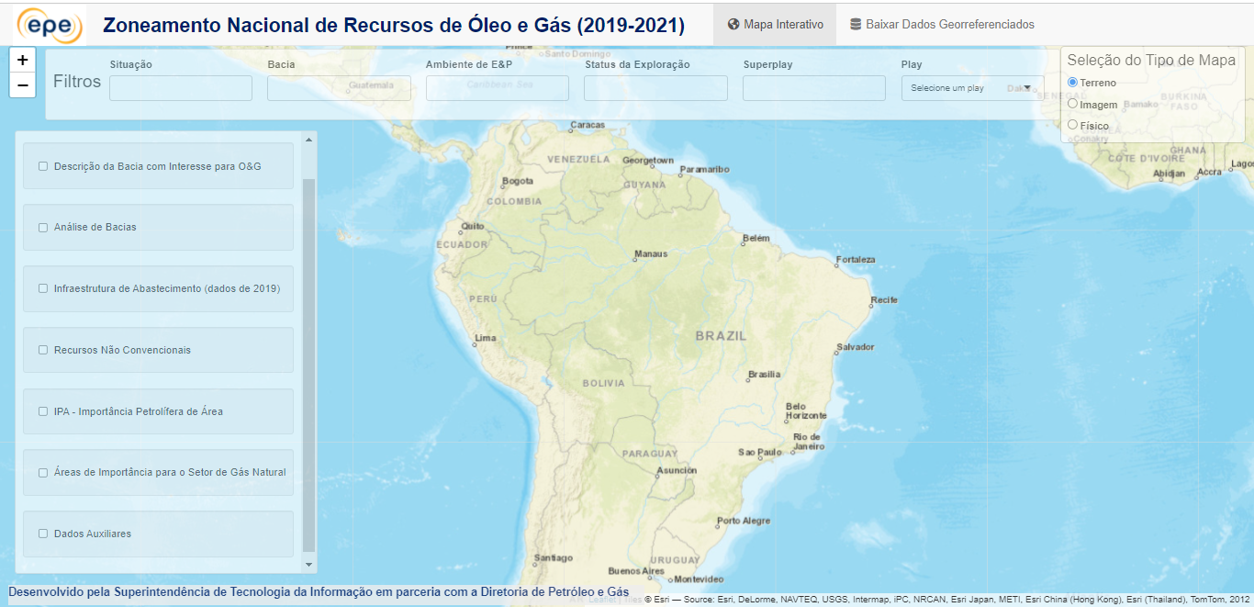
Interactive Panel
BIZROG - National Zoning of Oil & Gas Resources Information Database
Em atualização.
Após Consulta Pública, será divulgado novo link de acesso.
https://dashboard.epe.gov.br/apps/zoneamento-og/

Slide 43
References
ANP, 2021. Bacia da Foz do Amazonas: Sumário Geológico e Setores em Oferta. Disponível em: https://www.gov.br/anp/pt-br/rodadas-anp/oferta-permanente/opc/arquivos/sg/foz-amazonas.pdf.
ANP, 2022. Sumário Geológico e Setores em Oferta: Bacia de Pelotas. Disponível em https://www.gov.br/anp/pt-br/rodadas-anp/oferta-permanente/opc/arquivos/sg/sumario_geologico_op_pelotas.pdf.
CARVALHO, C.M.; D’ALMEIDA, K.S.; ZALÁN, P.V. 2025. Volumetric potential assessment of prospective resources of Devonian and Carboniferous plays in the Parnaíba Basin. First Break, 43 (2), p. 27-33.
CONTI, B. et al. 2017. Speculative petroleum systems of the southern Pelotas Basin, offshore Uruguay. Marine and Petroleum Geology, v. 83, p. 1-25.
COSTA, L.A.R., ZALÁN, P.V., DE MENDONÇA NOBRE, L.P. 2013. Estimativa da chance de sucesso exploratório: uma abordagem em três passos consistente com a classificação de recursos petrolíferos. Boletim de Geociências da Petrobras, Rio de Janeiro, v. 21/2, p. 313-324.
EPE 2024. Estimativa volumétrica da Bacia da Foz do Amazonas play Limoeiro. Disponível em https://www.epe.gov.br/sites-pt/publicacoes-dados-abertos/publicacoes/PublicacoesArquivos/publicacao-846/AP-EPE-DPG-SPG_16-2024-Volumetria%20da%20FZA_publica%201.pdf.
RODRIGUEZ, K., HUDGSON, N. 2024. Defying volcanic rifted passive margin models — World class Aptian source rock proven in the Orange Basin opens Venus, Graff and Mopane equivalent future “Golden Lanes” offshore Namibia and beyond. In: Fourth International Meeting for Applied Geoscience & Energy. Disponível em http://dx.doi.org/10.1190/image2024-4098655.1.
ROSE, P.R. 2001. Risk analysis and management of petroleum exploration ventures. AAPG Methods In Exploration Series, n° 12, 164 p.
SPE 2001. Guidelines for the evaluation of petroleum reserves and resources: a supplement to the SPE/WPC petroleum reserves definitions and the SPE/WPC/AAPG petroleum resources definitions. Society Of Petroleum Engineers, 141 p.
ZALÁN, P. V. 2017. Where Should we Drill in the Deep Waters of the Pelotas Basin, Southern Brazil and Uruguay?. In: AAPG Annual Convention & Exibition, 2017, Houston.
ZALÁN, P. V. 2017. Where Should we Drill in the Deep Waters of the Pelotas Basin, Southern Brazil and Uruguay?. In: AAPG Annual Convention & Exibition, 2017, Houston.

Slide 44

www.epe.gov.br
Praça Pio X, n. 54, 2º andar. Centro, Rio de Janeiro/RJ - Brasil

Slide 45



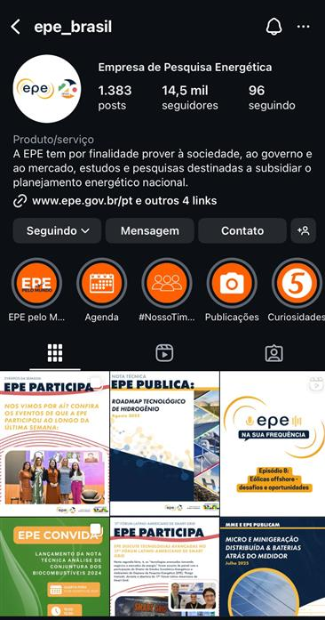
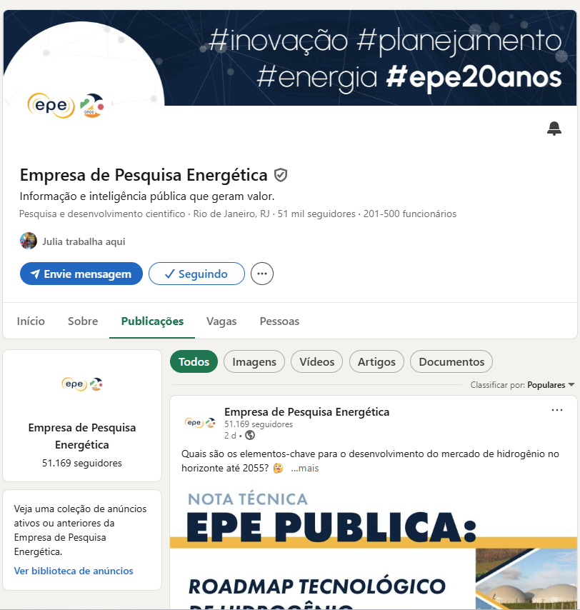
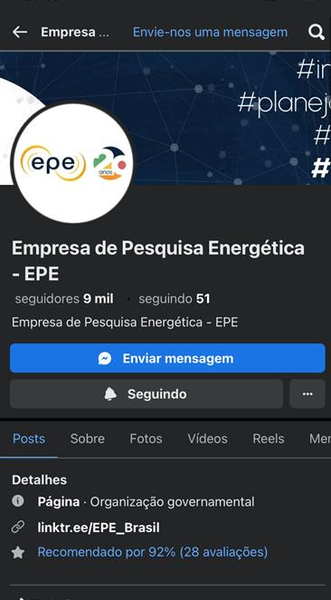

Connect with Us
Instagram
Linkedin
Facebook
https://www.epe.gov.br/pt

